Slide 1
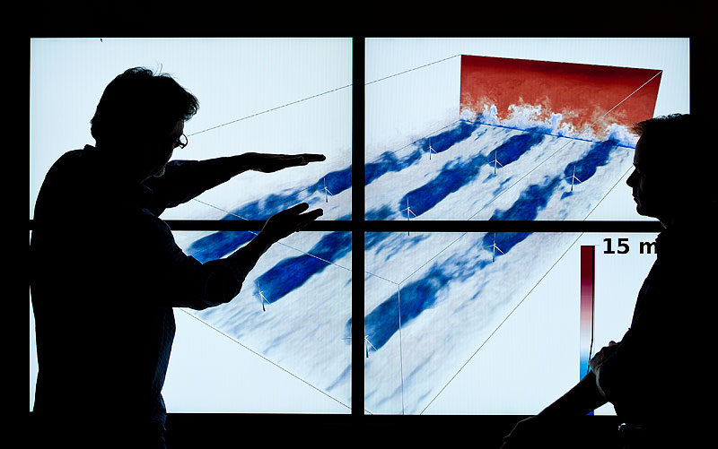
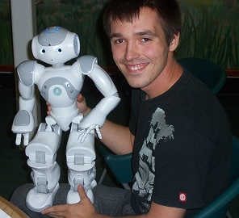
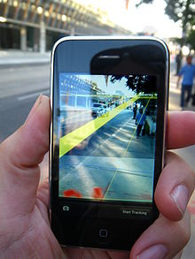
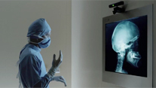
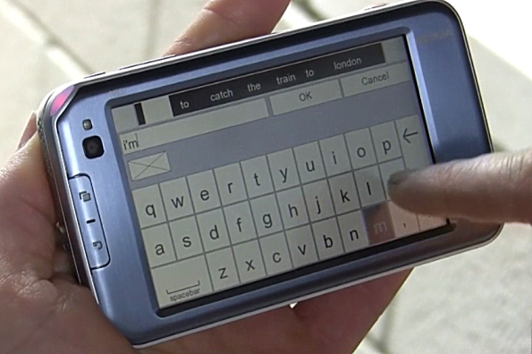
Computer Science Fun and Games For $4,000!
Jon Wareham, senior in SE & CS
Jake Jones, senior in SE
Jordan Yates, senior in CS
PJ Neary, senior in CS
Phil Winninghoff, department volunteer
Frank Ackerman, Professor

Slide 2
Introductions
Students:
Phil Winninghoff (special student & department volunteer)
Jordan Yates (senior in software engineering)
PJ Neary (senior in computer science)
Jake Jones (senior software engineer)
Jon Wareham (senior in computer science and software engineering0
Faculty
Frank Ackerman
Frank Ackerman, Associate Professor

Slide 3
Purpose of this Presentation
Have some fun!
Learn a little something about computer programming and associate careers
Letting you know of a relatively easy way to earn a $4,000 scholarship
Actually experience writing and running a computer program (prizes!)
Frank Ackerman, Associate Professor

Slide 4
Getting Set Up
Go to www.codehs.com/login
Login in
Go to sandbox (menu item)
Will look something like ---
Frank Ackerman, Associate Professor

Slide 5
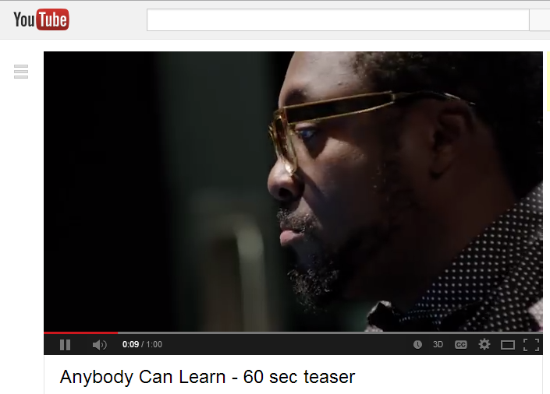
http://www.youtube.com/watch?v=qYZF6oIZtfc

Slide 6
Side Note
Several of the people you just saw are multi-billionaires!
Frank Ackerman, Associate Professor

Slide 7
Student Stories
Frank Ackerman, Associate Professor

Slide 8
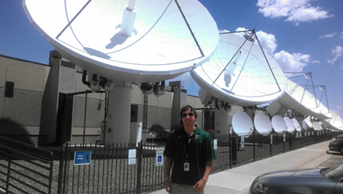
PJ at EchoStar in Denver

Slide 10
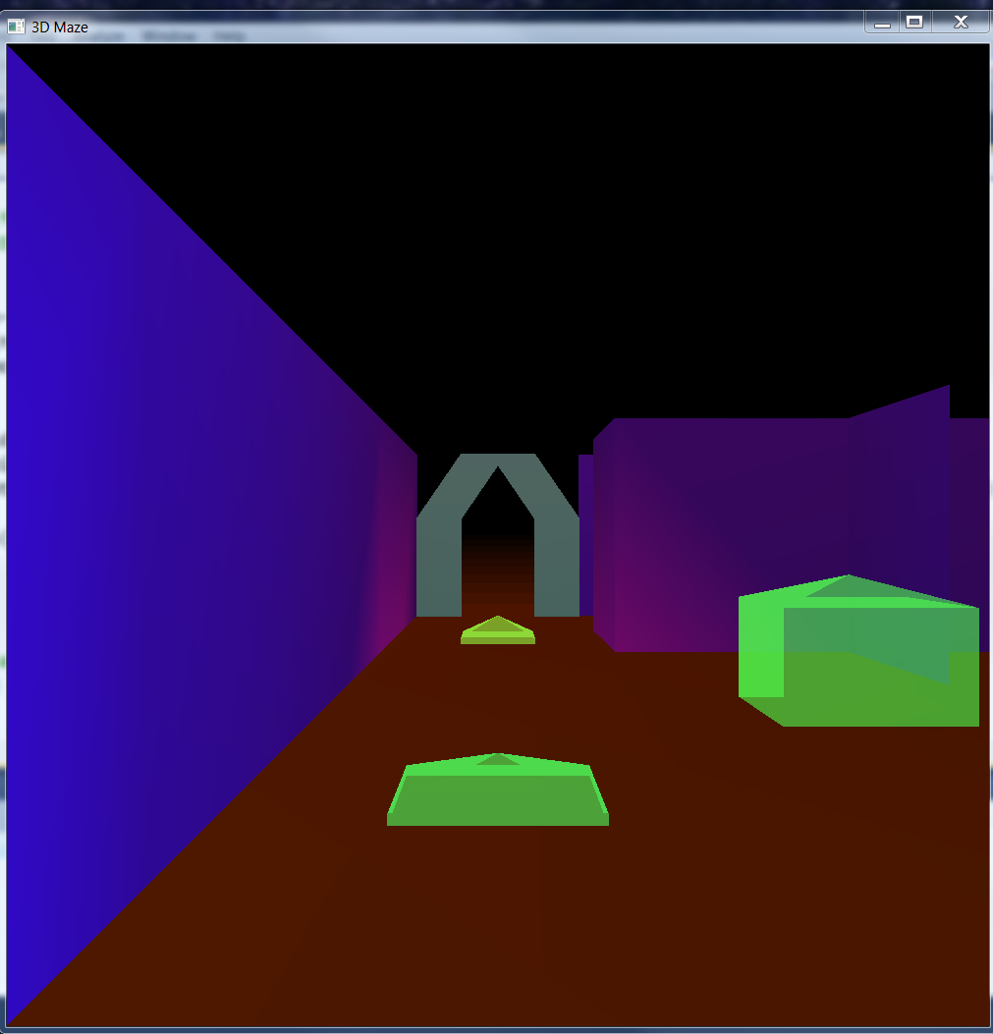
A Game By Jon Wareham

Slide 11
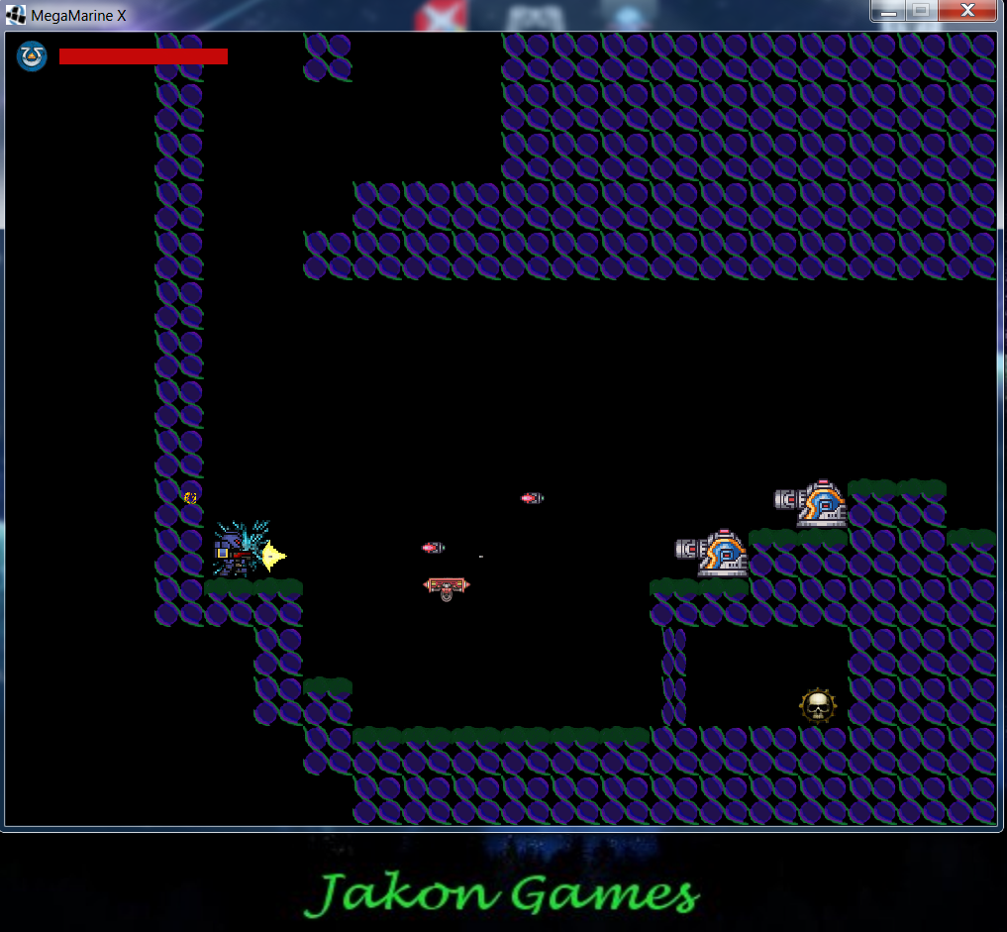
A Game By Jon Wareham & Jake Jones

Slide 12
Career Opportunities
Lots!
Frank Ackerman, Associate Professor

Slide 13
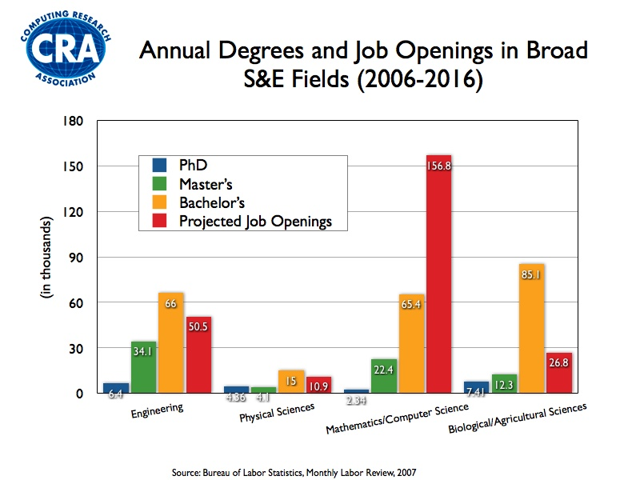

Slide 14
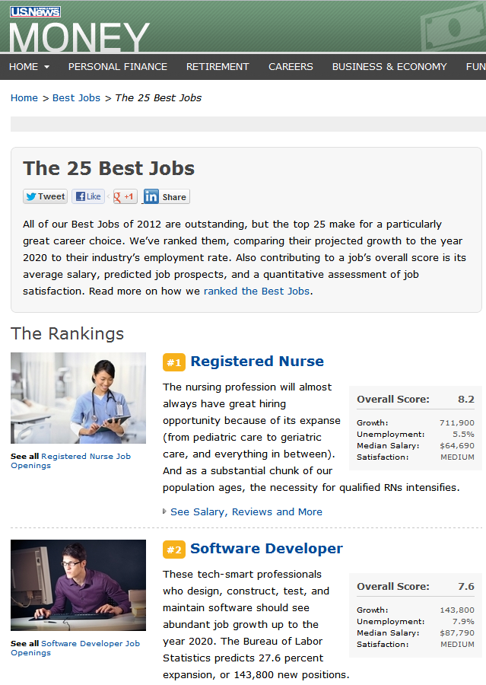
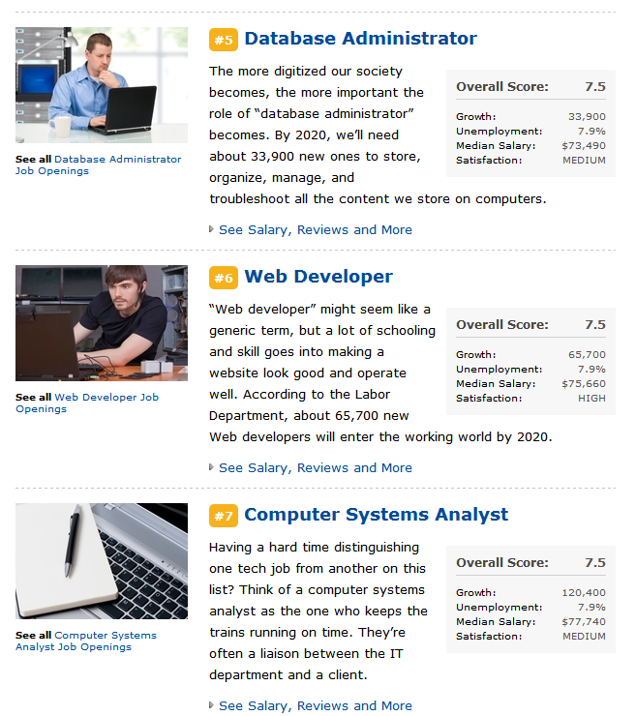

Slide 15
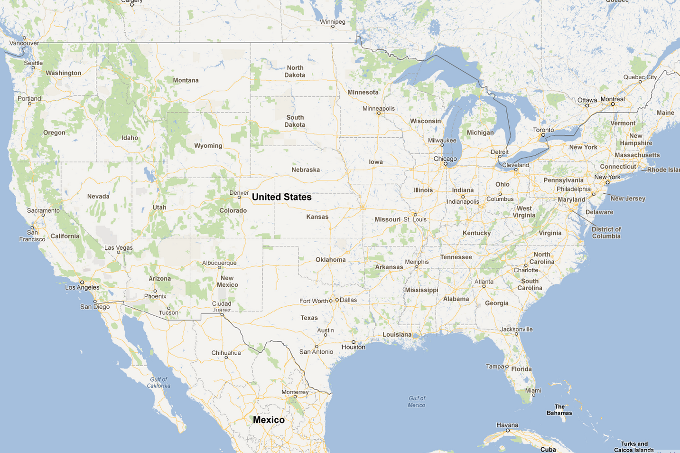
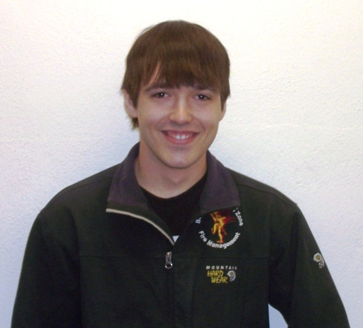
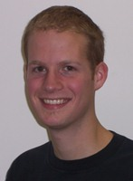
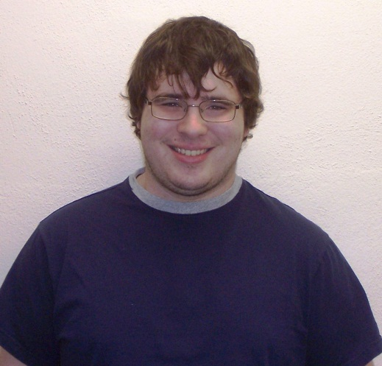
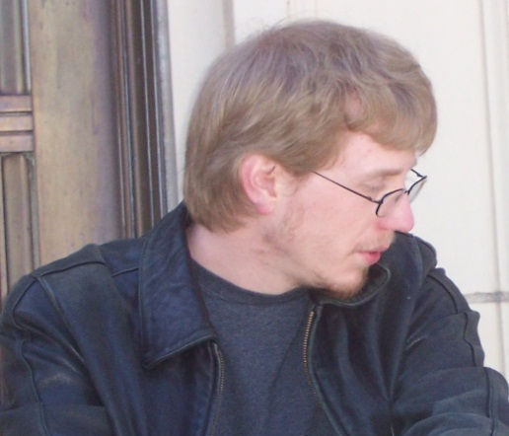
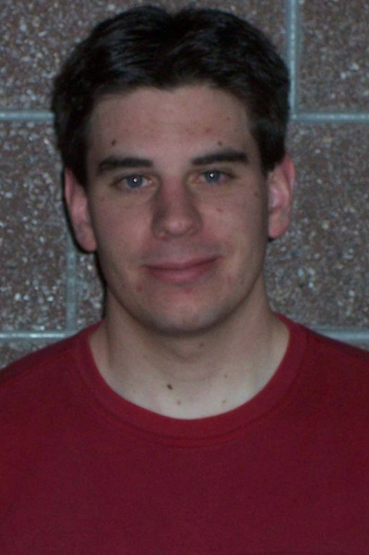
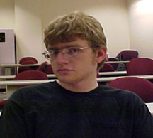
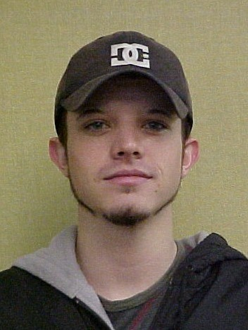
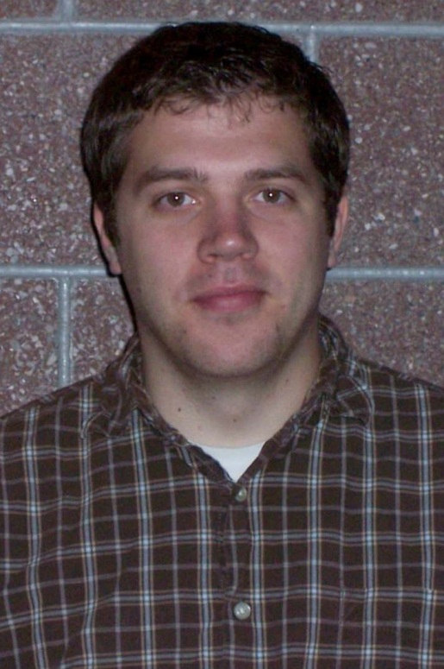
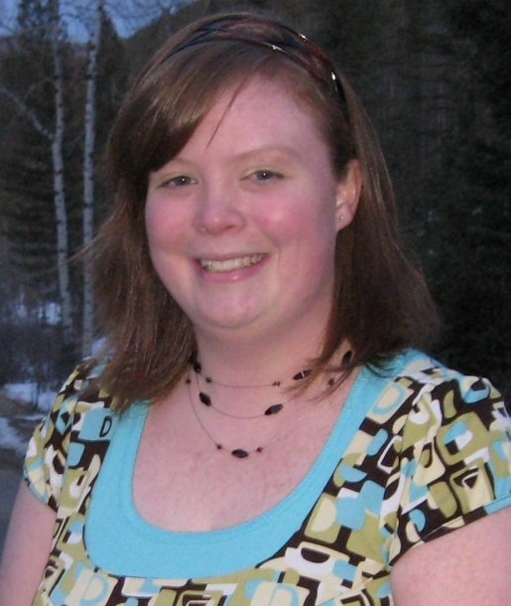
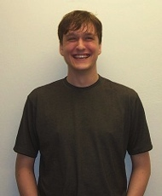
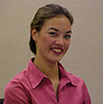
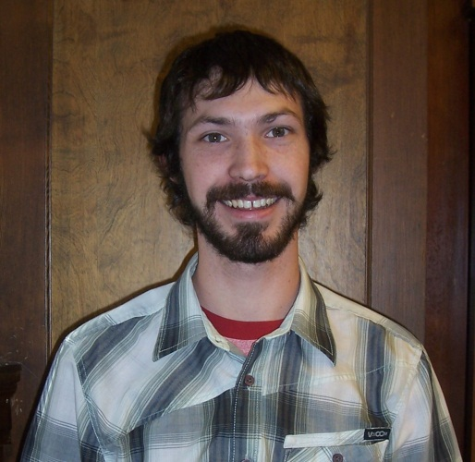
Where can I get a job in computer science?
Mikeal Day
AMSEC
Seattle, WA
Dan Loeschke
Micron
Boise, ID
Jake Fjermsted
Energy Labs
Billings, MT
Chris Tenda
EchoStar
Denver, CO
Brent Foley
HP
Boise, ID
Steve Marmon
Apple
San Francisco, CA
Brian Myers
Zoot
Bozeman, MT
Jim Ellwood
Oracle
Bozeman, MT
Megan Farbo
Intl'l Game Technology
Reno, NV
Chris Ostrum
Sierra Nevada
Denver, CO
Diane Lowe
Boeing
Los Angeles, CA
Tyler Lee
Micron Technologies
Boise, ID
Dan Johnson
Cisco
San Jose, CA
George Cox
GE
Bently, Nevada

Slide 16
Getting One of These Juicy Jobs
One way: Get a Bachelor’s degree in CS or SE at Tech
Expensive!
Scholarships:
$1,200 REAL scholarship (cs.mtech.edu)
$4,000 CodeMontana scholarship (pick up flyer)
More about CodeMontana in a moment
Frank Ackerman, Associate Professor

Slide 17
Introduction to CodeHS
A superb teaching environment with videos and quick quizzes
Starts at kindergarten level
But moves quickly (and clearly) to advanced topics
Can actually make some fun stuff. E.g.: http://www.codehs.com/editor/showcase/38598/6/27
CodeMontana is a version of CodeHS
Free access to Montanans (also prizes!)
www.codemontana.org
Mentoring help available
Frank Ackerman, Associate Professor

Slide 18
Result of DemoTurnRight
Frank Ackerman, Associate Professor

Slide 19
DemoTurnRight start
Command 1: ?
Command 2: ?
Command 3: ?
Command 4: ?
Command 5: ?
Command 6: ?
Frank Ackerman, Associate Professor

Slide 20
Tech Challenge!!
In your sandbox TechChallenge write a Karel program using a turnRight() function that goes:
A prize for any student who does the above in the fewest lines of code! (a line with just ’}’ does not count as a line of code.
Hint 1: Get a solution first, then try to make it smaller
Hint 2: Loops can be nested! 4 sides, and ? moves each side
Frank Ackerman, Associate Professor

Slide 21
Instructor and your teacher has copies of CodeMontana contest flyer.

