Slide 1
Preattentive Variables
(Jennifer Tidwell)

Slide 2
Preattentive Variables
Information communicated subconsciously prior to explicit awareness.
Processed in spatial memory without conscious action.
Powerful data visualization should work quickly & effectively
  Visual design should help reveal the data to the user

Slide 3
Preattentive Variables
Motivating Examples:

Slide 4
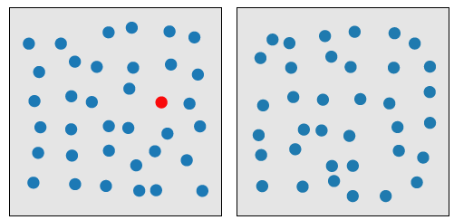
Preattentive Variables
COLOR:
  [Red circles vs. blue circles on board]

Slide 5
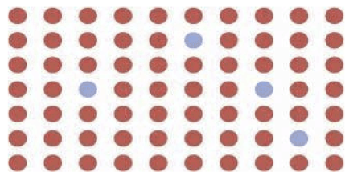
Preattentive Variables
COLOR:
  [Red circles vs. blue circles on board]

Slide 6
Preattentive Variables
SIZE

Slide 7
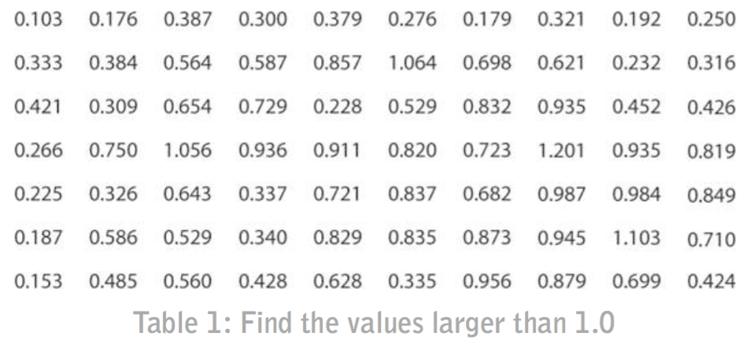
Preattentive Variables

Slide 8
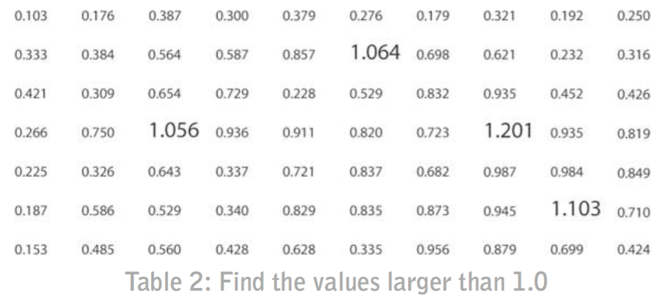
Preattentive Variables

Slide 9
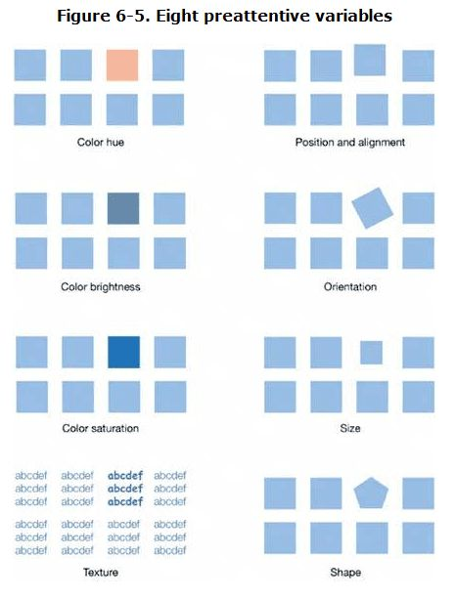
Preattentive Variables
Color
  Hue
  Brightness
  Saturation
Position / Orientation
Texture / Size / Shape

Slide 10
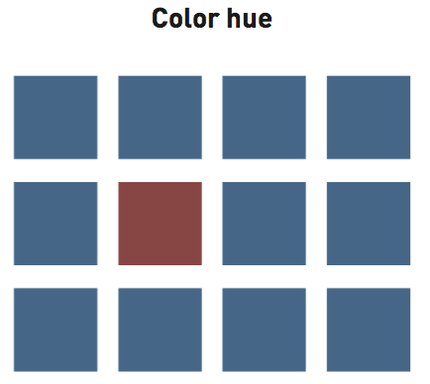
Preattentive Variables

Slide 11
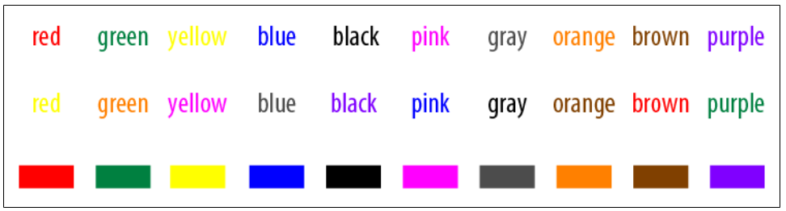
Color Hue
Avoid using color as a way to encode rank, order, intensity, or values
Vary brightness or saturation is effective for heat maps and relative intensity
Excellent property for categorical data or non-ordered categories (region, genre, etc.)
Source: DDV

Slide 12
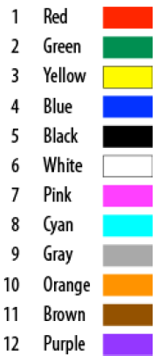
Color Hue
Best to limit encoded colors and categories to 6
Ideally no more than 12 colors
Best to use colors from first half of image on left
Source: DDV

Slide 13
Color Hue
Leverage Common Color Associations
Red: warning, danger, and warfare
Green: nature, the earth, environmentalism, renewal.
Yellow: happiness, sunshine, playfulness.
Blue: water, coolness, calm.
Black: mourning, death, luxury, sophistication.
White: purity, innocence, weddings.
Pink: affection, imagination, childishness.
Grey: neutrality, conservatism, modesty, maturity.
Orange: fire, energy.
Brown: dirt, leather, stone, earthiness, animal waste.
Purple: royalty, magic.
Source: DDV

Slide 14
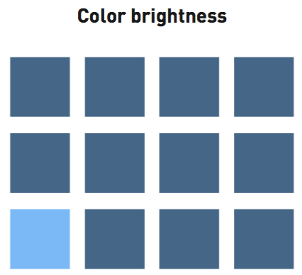
Preattentive Variables

Slide 15
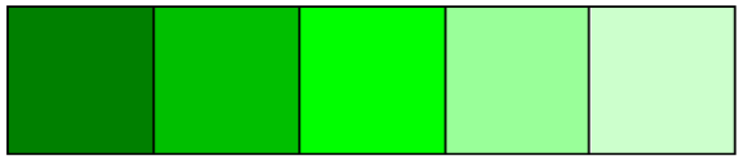
Color brightness

Slide 16

Spatial Effects of Color
Source: DDV

Slide 17
Spatial Effects of Color
Warm colors (red, orange, yellow, brown) - advance into foreground.
Cool colors (green, blue, purple, grey) - recede into background.

Slide 18
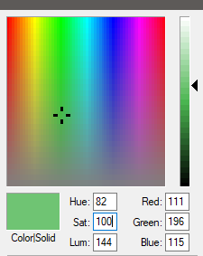
Color Saturation
The amount of grey in a color

Slide 19
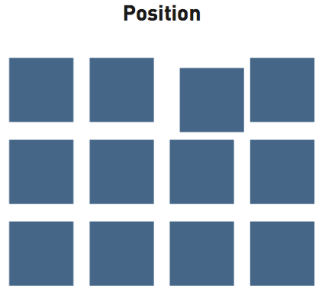
Preattentive Variables

Slide 20
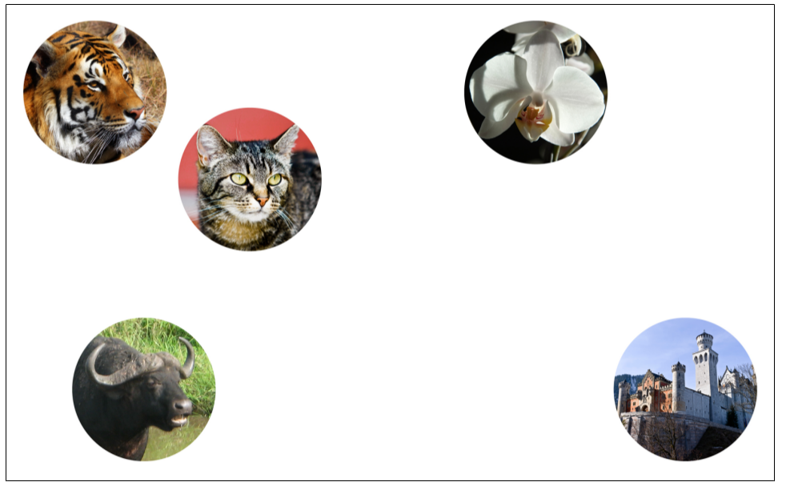
Position
Source: DDV

Slide 21
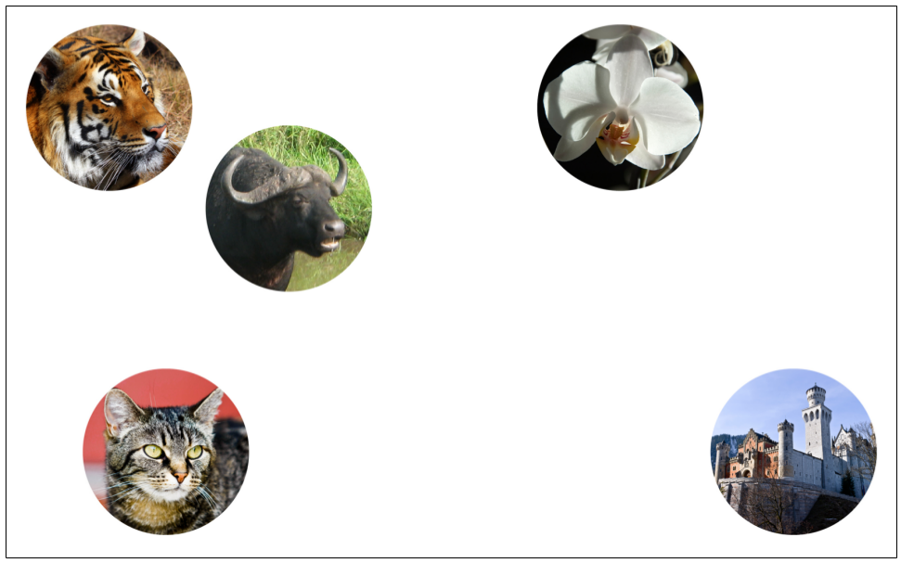
Position
Source: DDV

Slide 22
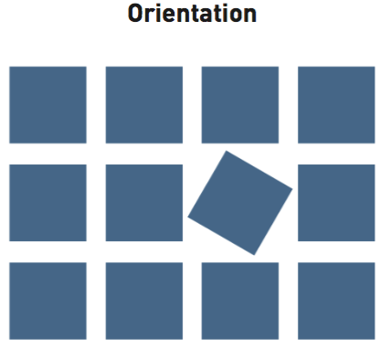
Preattentive Variables

Slide 23
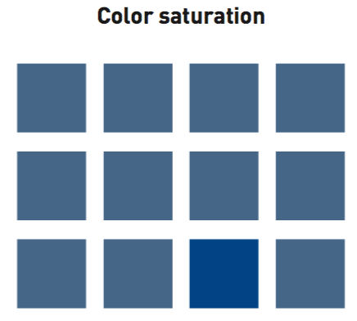
Preattentive Variables

Slide 24
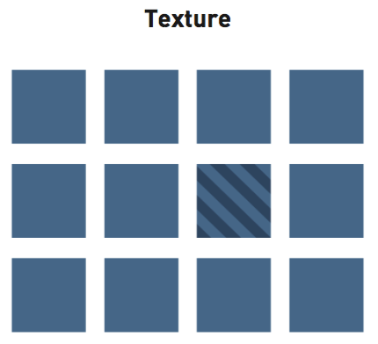
Preattentive Variables

Slide 25
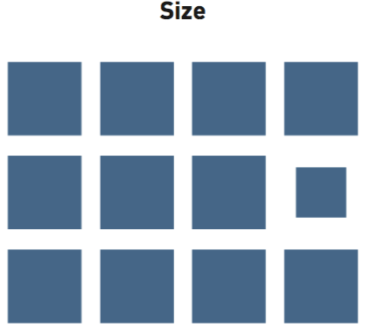
Preattentive Variables

Slide 26
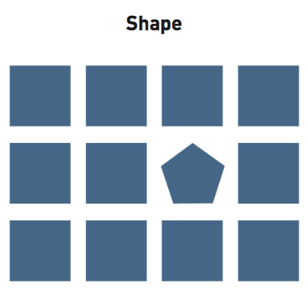
Preattentive Variables

Slide 27
Colin Ware –
4 preattentive properties
Color (Hue, Saturation, Lightness)
Form (Orientation, curvature, length/breadth/width, shape, size, spatial grouping, etc.)
Movement
Spatial Positioning
Reference

Slide 28
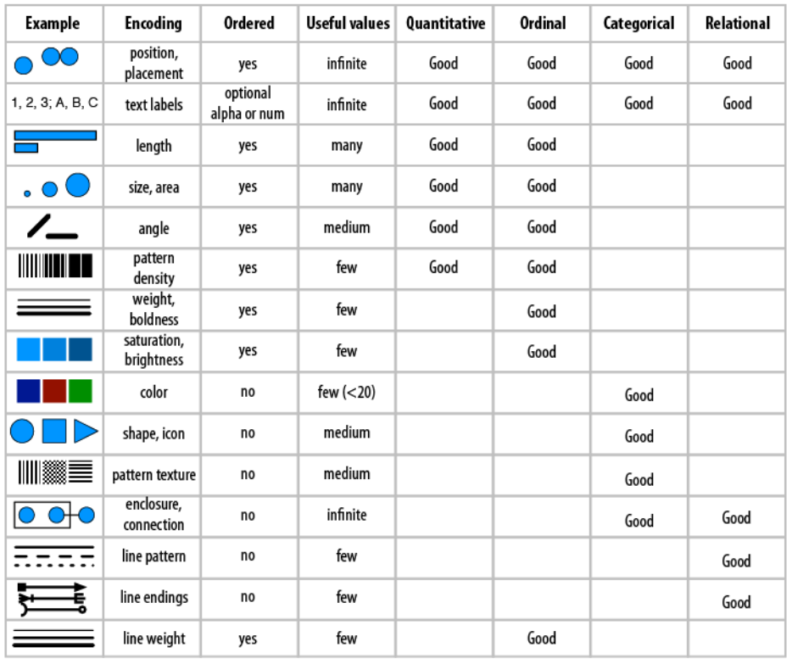
Source: DDV

Slide 29
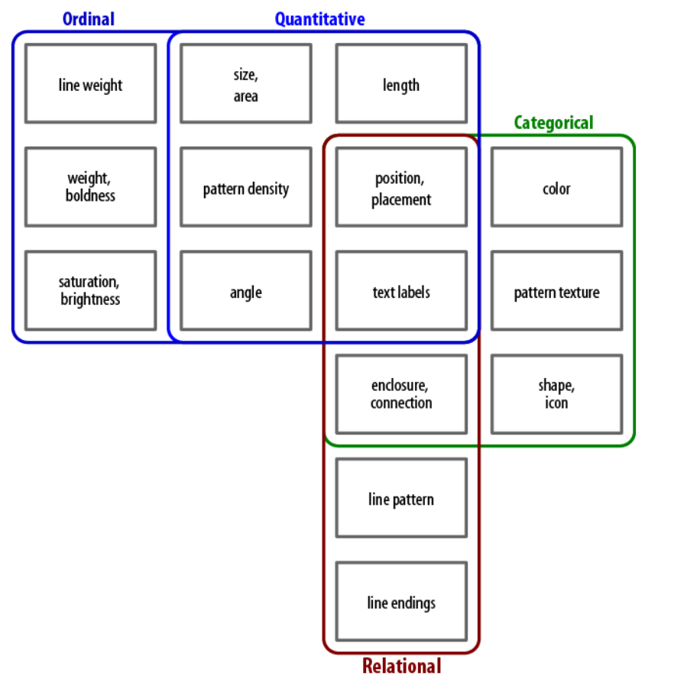
Source: DDV

Slide 31
Drop Shadows also add visual noise,

Slide 32
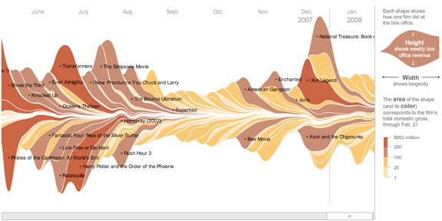

Slide 33
Data Dimensionality
The number of discrete channels of information embedded in the data.
How do you determine this from data?
How do you design an effective visualization for the dimension?

Slide 34
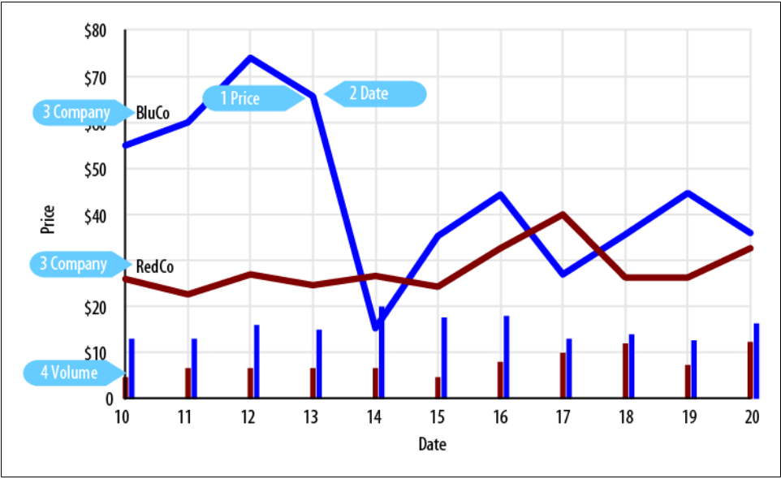
Data Dimensionality
Source: DDV

Slide 35
Data Dimensionality
Does adding to the number of data points increase dimensionality?

Slide 36
Data Dimensionality
The challenge:
  For every additional dimension, you have to find another visual description.
  There are limited visual channels/tactics.
  How do you decide which dimensions to visualize and how to do so?

