Slide 1
Programming Languages
Type Systems,
Chapter 7

Slide 2
Objective
Today’s primary objective:
You know the purpose of type systems
You know that type systems can be static/dynamic, weak/strong (not well defined), gradual, duck
You know pros and cons of static and dynamic typing
You know what is meant by orthogonal

Slide 3
Type System
Introduction to type systems
Forms of type systems
Languages employing each type and coding examples
Implementation
Pros and cons
Questions

Slide 4
Type System Definition
Type Systems – set of rules that assign a “type” to computer program constructs such as variables, expressions, functions or modules.

Slide 5
Purpose of Type Systems
Provide an implicit context
Enable checking to make sure that certain meaningless operations do not occur (It can’t catch all, but enough to be useful)
If declared explicitly, a kind of stylized documentation
Enable some optimizations

Slide 6
Common Types
Discrete types
integer, float, Boolean, char, enumeration
Composite types
records, arrays (strings), sets, pointers, lists, files

Slide 7
Forms of Type Systems
Weak versus Strong
Static versus Dynamic

Slide 8
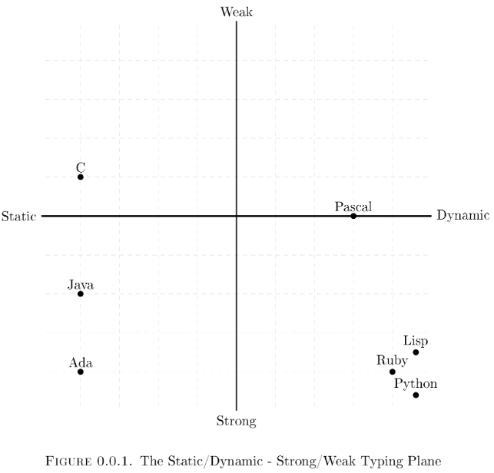
Typing
https://stackoverflow.com/questions/2351190/static-dynamic-vs-strong-weak
Notes:
Prolog – original versions were untyped.
Turbo Prolog from Borland was strongly typed
Untyped Prolog doesn’t raise type errors, but two terms may not unify and you have to debug the program to discover why.
Prolog is dynamically types following the Lisp tradition Mercury is similar to Prolog but adds an algebraic type system and insists that every term is typed.

Slide 9
Forms of Type Systems
 | Static | Dynamic
Weak | C | Perl JavaScript
Strong | C++ (mostly strong) Objective C (mostly strong) Java C# Rust Scheme | Python Ruby Lisp Borland’s Prolog
Notes:
C++ is mostly strongly typed . Explicit “casts” are required. It does support “void” pointers, which makes it only “mostly” strongly typed .
Objective C is a completely different language than C++. C++ relies on static structure whereas Objective C relies on run-time OO behavior.

Slide 10
Other terms
Gradual typing – variables may be typed at compile or run-time. Allow developers to choose static or dynamic within a single language
Duck typing (typically considered style of dynamic typing) – infer the type based on how it is used
Notes:
Duck typing enables redefining any object in the middle of the program. Example is given.

Slide 11
Type Inference
Inferring the type (duck typing) is used in some strongly typed languages:
Rust
C++ (version 11 and up)
C# (version 3.0 and up)
Java (version 10 and up)
F#
Go
functional languages

Slide 12
Strong versus Weak Type Systems
Strong – language defines each type of data. Variables and expressions must be described with one of these data types
Weak – many operations allowed without regard to types of the operands (typically dynamically typed)
Terms not well defined. Wikipedia says “No universally accepted definition for strong and weak typing”

Slide 13
Static versus Dynamic Type Systems
Static – variables are typed at compile time
Dynamic – variables are typed at run-time
Well defined, although a language may use aspects of both (gradual typing)

Slide 14
Type System in C
C is weakly, statically typed
All variables must be declared and typed, however, it doesn’t enforce the type.
byte foo = 5;
int f = foo; //this is valid, the variable
// "foo" will be implicitly // converted to an int

Slide 15
Type System in C continued
C sort of provides dynamic typing via void *type
Example:
int i;
float f;
double d;
void *p = &i;
p = &f;
p = &d;

Slide 16
Python Implicit Conversion
a_int = 1
b_float = 1.0
c_sum = a_int + b_float
print(c_sum)
Print(type(c_sum))
2.0
<class ‘float’>
Notes:
Conversion int to float is widening and ok
Conversion float to int is narrowing and is not ok

Slide 17
Python Explicit Conversion
price_cake = 15
price_cookie = 6
total= price_cake + price_cookie
print (“The total is: “ + total + “$”)
Gives error.
print (“The total is: “ + str(total) + “$”)

Slide 18
JavaScript - dynamic and strong
Change object type based on program conditions:
var person = {
getName: function() {
return ‘Zack’;
}
};
if (new Date().getMinutes() > 29 {
person = 5; // “weakly” allows changing data type
}
alert(‘The name is ‘+ person.getName());
// strongly gives error message
Notes:
Code will work at 9:15 but will fail at 9:30. Java would have found a type error, but it’s fine in JavaScript.

Slide 19
Strong versus Static
Strong Typing – language prevents programmers from applying an operation to data on which it is not appropriate
Static Typing – compiler can do all the checking at compile time

Slide 20
Common Terms in Type Systems - Orthogonality
A collection of features is orthogonal if there are no restrictions on the ways in which the features can be combined
Orthogonality – useful goal in the design of language, particularly in its type system

Slide 21
Orthogonality
Orthogonality makes a language easy to understand, easy to use, and easy to reason about.
Orthogonality maximizes the expressive power of the language, yet increases the number of independent primitive concepts. It avoids deleterious superfluities.

Slide 22
Type Orthogonality Example
Pascal is more orthogonal than Fortran
In Pascal can make arrays of anything
Orthogonal instruction set - all instruction types can use all addressing modes

Slide 23
Orthogonality – All 1st Class
A value is:
1st class if it can be passed as a parameter, returned from a subroutine or assigned into a variable.
2nd class can be passed as a parameter but not returned from a subroutine or assigned into a variable
3rd class cannot even be passed as a parameter

Slide 24
Strong versus Static Examples
Java – strongly typed with a non-trivial mix of things that can be checked statically and things that have to be checked dynamically
Common Lisp - strongly typed, but not statically typed
Ada – both strongly and statically typed
Pascal - almost statically typed
Notes:
JavaScript is weakly typed – allows for flexibility in terms of implicit conversions
JavaScript is dynamically typed – it uses “duck typing”
PHP – is dynamically typed with a couple of static type features
Swift – strongly and statically typed
C – strongly, stoically typed. All variables must be declared and typed. It has no type inferences as in many modern statically typed languages. The compiler generates code based on the type of variables and this type cannot be changed at run time.
Objective C – mixture of static and dynamic typing since it used a message passing paradigm where the message name and target are encoded at compile time, but the address of the code to execute is looked up at runtime by the Objective-C runtime libraries.
Objective-C is a layer on the C language, so it can have both static and dynamic types. Static if you’re using the base-C stuff. Dynamic if you’ve using the Objective-C extensions.
So Objective-C is strongly, statically typed, but it has dynamic method resolution for message passing. Plain C objects are statically typed, but Objective-C objects are dynamically typed. The Objective-C runtime does not care what type an object is as long as the messages you send to your objects are recognized by the object.

Slide 25
Pros Static Typing
Earlier detection of programming mistakes
Better documentation in the form of type signatures
More opportunities for compiler optimizations
Increased runtime efficiency

Slide 26
Pros Dynamic Typing
Ideally suited for prototyping systems with changing or unknown requirements
Good when dealing with truly dynamic program behavior
Code is more reusable
Code is more concise
Code is not any less safe (some claim)
Code is not any less expressive (some claim)

