Slide 1
Programming Languages
Attribute Grammars
Chapter 4

Slide 2
Objective
Today’s primary objective:
Distinguish between syntax and semantics in programming languages
Know how attribute grammars can be used to enforce semantics of programming languages
Practice writing attribute grammars

Slide 3
Syntax and Semantics
In general:
Syntax – form
Semantics – meaning
In programming languages:
Syntax – part of the language definition that can be described via a context-free grammar
Semantics – part of language definition that can’t.

Slide 4
Non-Syntax Items
Can’t be enforced by a context-free grammar:
Variables must be declared before use
Variables must be assigned before use
Type compatibility in expressions
Number and type of arguments must match the number and type of formal parameters
Procedure must contain a return statement for each execution path

Slide 5
Attribute Grammars
Semantic analysis and code generation can be described in terms of annotation, or “decoration” of a parse or syntax tree
Attribute grammars provide a formal framework for decorating such a tree

Slide 6
Example Context-Free Grammar
E → E + T E → E – T E → T T → T * F T → T / F T → F F → - F
Says nothing about what the program means

Slide 7
Example Attribute Grammar
E → E + T
E1.val = E2.val + T.val E → E – T
E1.val = E2.val - T.val E → T
E.val = T.val T → T * F
T1.val = T2.val * F.val T → T / F
T1.val = T2.val / F.val T → F
T.val = F.val F → - F
F1.val = - F2.val

Slide 8
Evaluating Attribute Grammars
Attribute grammar variables can be characterized as:
Intrinsic – look-up value
Synthesized – Variables on the left side of a production get attribute values calculated from values on the right side of the production. In other words, attribute values come from values lower in the parse tree.
Inherited – Variables on the right side of a production get attribute values from items on the left side of the production or items to the left of the variable. In other words, values come from parents or siblings on the right in the parse tree.

Slide 9
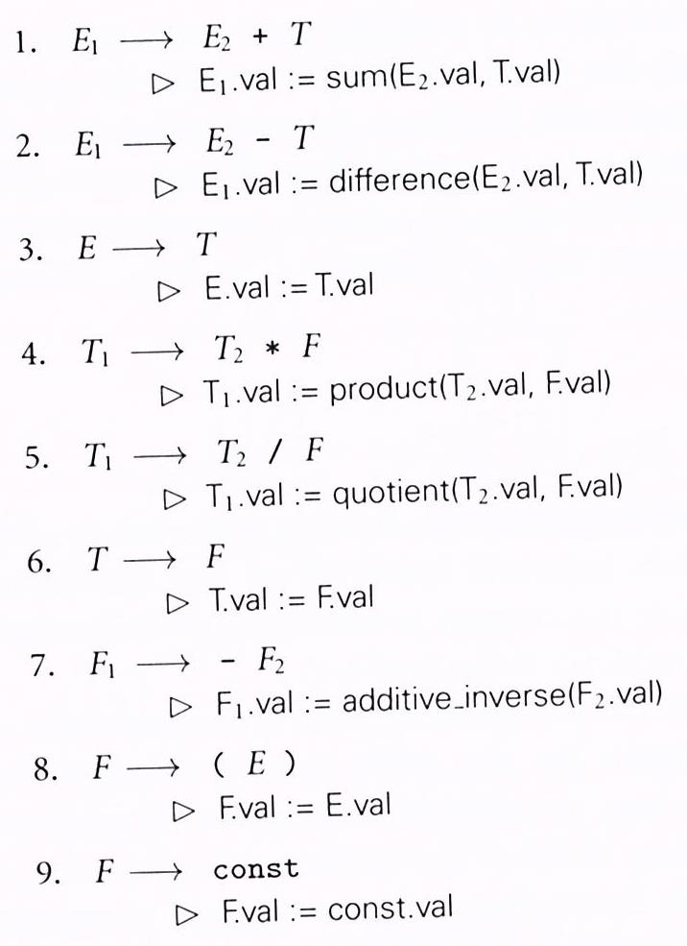
Synthesized Attributes
Simple attribute grammar for constant expressions using standard arithmetic operations
Figure 4.1, page 186

Slide 10
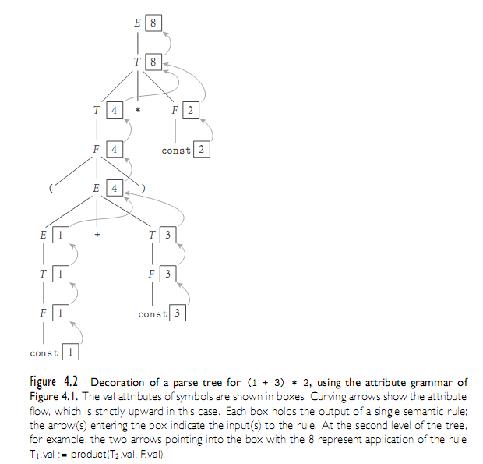
Evaluating Attributes

Slide 11
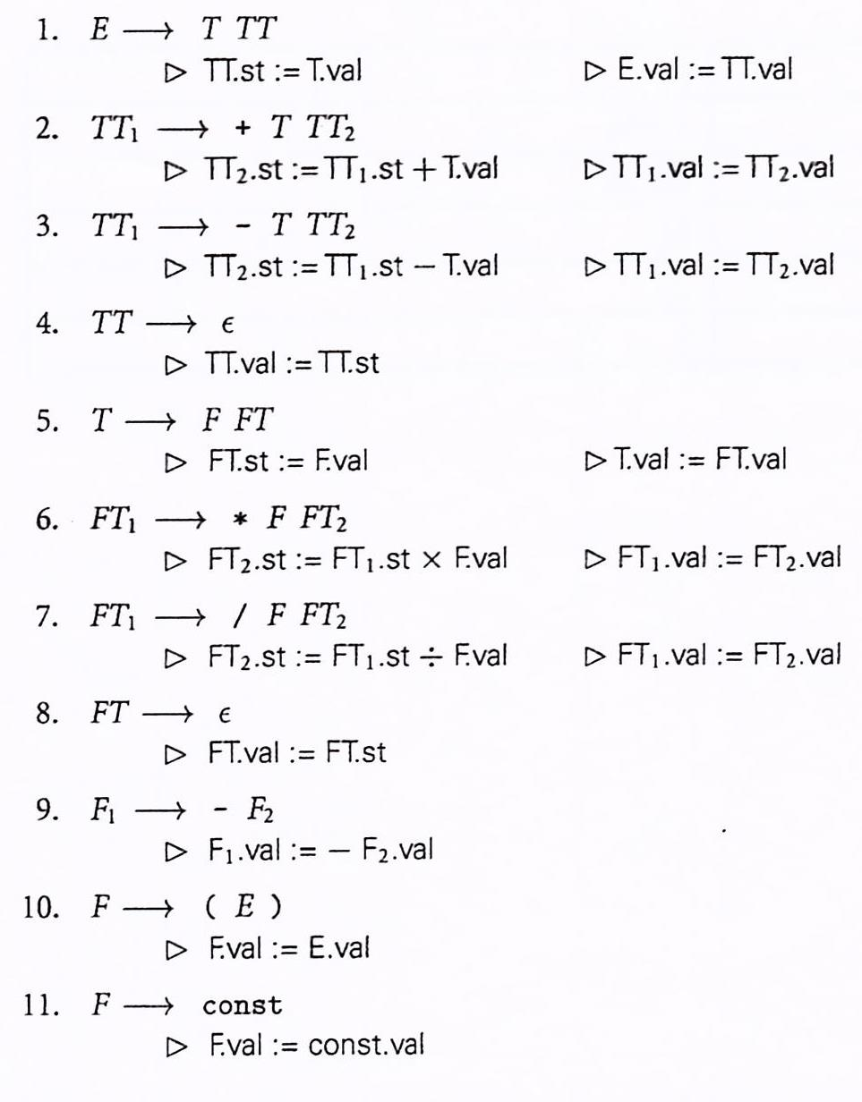
Synthesized & Inherited Attributes
Attribute grammar for constant expressions based on LL(1) context-free grammar. Several productions have two semantic rules
Figure 4.3, page 190

Slide 12
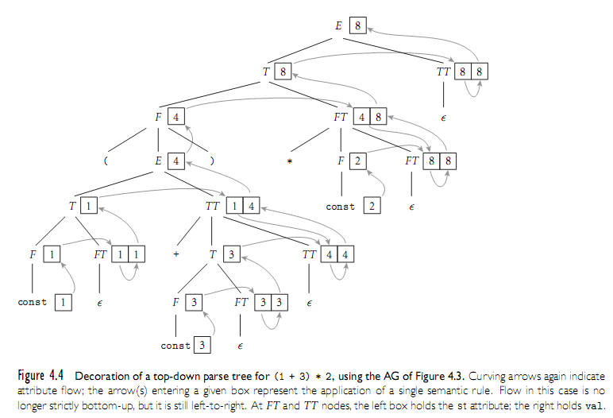
Evaluating Attributes - Example

