Slide 1
Software Testing

Slide 2
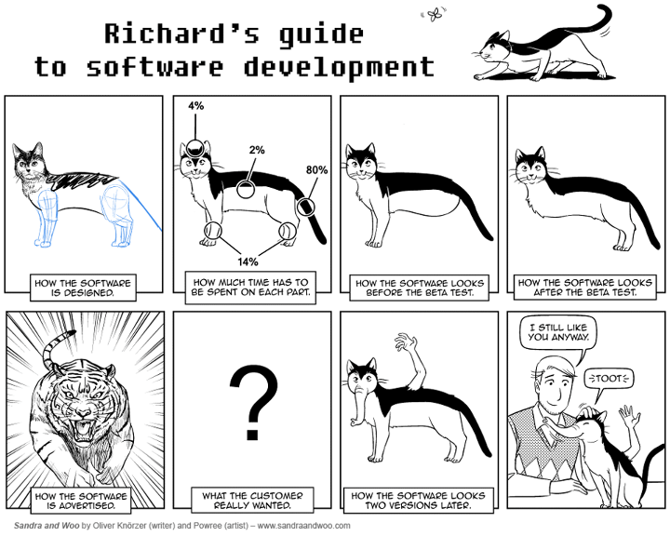
Outline
Software Quality
Unit Testing
Integration Testing
Acceptance Testing

Slide 3
Unit Testing Overview
Unit testing is testing some program unit in isolation from the rest of the system
Usually the programmer is responsible for testing a unit during its implementation
Easier to debug when a test finds a bug (compared to full-system testing)

Slide 4
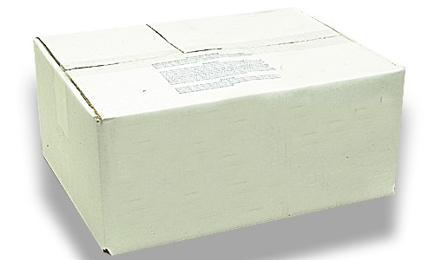
Unit Testing Strategies
Black box (specification-based) testing
White box (program-based) testing, aka glass-box
Normally perform both (not alternatives!)

Slide 5
White Box Testing
Test suite constructed by inspecting the program (code)
Look at specification (requirements, design, etc.) only to determine what is an error
Attempt to exercise all statements, all branches, or all paths (control flow and/or data flow)
Intuition: If you never tested that part of the code, how can you have any reason to believe that it works?

Slide 6
Whitebox Approaches to Unit Testing
Execute all (reachable) statements
Execute all branches of logical decisions, including boundaries of loops
Execute all (feasible) control flow paths in combination
Execute all data flow paths (from each variable definition to all its uses)
Usually applied only to individual subroutines rather than larger unit (due to combinatorics)

Slide 7
Example
Consider a function that takes as input a string assumed to be a URL and checks to see if it contains any characters that are illegal
Illegal URL characters are control characters (ascii 0-31, 127), space (ascii 32), and delimiter characters (">", "<", "#", "%", and the double quote character)
The function returns true if the URL is valid (does not contain an illegal character), and false if the URL is invalid (contains an illegal character)

Slide 8
def isLegalURL (url):
valid = True
i = 0
while i < len(url) and valid:
c = url[i]
if ord(c) >= 0 and ord(c) <= 32:
valid = False
else:
if c == '>' or c == '<' or c == '#' or c == '%' or c == '\\':
valid = False
i += 1
return valid

Slide 9
Black Box Testing
Test suite constructed by inspecting the specification (requirements, design, etc.), not the source code
Tests unit against functional and, sometimes, extra-functional specifications (e.g., resource utilization, performance, security)
Attempts to force behavior (outcome) that doesn't match specification

Slide 10
Blackbox Approaches to Unit Testing
Functional testing – exercise code with valid or nearly valid input for which the expected outcome is known (outcome includes global state and exceptions as well as output)
Exhaustive testing usually infeasible, so need way(s) to select test cases and determine when “done” testing
Choose test cases to attempt to find different faults
Equivalence partitioning
Boundary value analysis

Slide 11
Equivalence Partitioning
Assume similar inputs will evoke similar responses
Equivalence class is a related set of valid or invalid values or states
Valid inputs
Invalid inputs
Errors, exceptions, and events
Boundary conditions
Everything that could possibly break!
Only one or a few examples are selected to represent an entire equivalence class
Good for basic functionality testing

Slide 12
Equivalence Partitioning
Divide input domain into equivalence classes
Divide outcome domain into equivalence classes
Need to determine inputs to cover each output equivalence class
Also attempt to cover classes of errors, exceptions and external state changes

Slide 13
Boundary Value Analysis
Consider input values that are “between” different expectations of functionality
Sometimes called “corner cases”
Programmers tend to make common errors
Off-by-one
“<” instead of “<=”

Slide 14
Example
A student must be registered for at least 12 points to be considered full-time
Full-time: some number 12 or greater
Not full-time: some number less than 12
The method isFullTime takes an int and returns a boolean
What inputs should we use to test it?

Slide 15
Another Example
The function stringSqrRoot takes a String as input, converts it to a number, and returns that number’s square root
It throws an exception if the String is not numeric
What inputs should we use to test it?

Slide 16
Unit Testing Summary
Unit testing is testing some program unit in isolation from the rest of the system
Usually the programmer is responsible for testing a unit during its implementation
Strategies:
Black box (specification-based) testing
White box (program-based) testing
Normally perform both (not alternatives!)

Slide 17
unittest
import unittest
from TestMe import isLegalURL
class URLTestCase(unittest.TestCase):
def test_valid(self):
self.assertTrue(isLegalURL('cs.mtech.edu'))
def test_space(self):
self.assertFalse(isLegalURL('cs.m tech.edu'))
# … and a whole bunch of other tests in here…
def test_quote(self):
valid = isLegalURL('cs.mtech"edu')
self.assertEqual(valid, False)
def test_valid2(self):
valid = isLegalURL('www.google.com')
self.assertEqual(valid, True)
if __name__ == '__main__':
unittest.main()

