Slide 1
Natural Language Processing
Chris O’Neill
Notes:
Very brief overview of NLP – very large field of study

Slide 2
Overview
What is NLP
Main challenges with NLP
Rule-based vs Statistical NLP
Hidden Markov Models
Modern Applications of NLP

Slide 3
What is Natural Language Processing?
Goal: “analyze and process human language, broadly, robustly, and accurately”
Computers being able to understand how we speak and write
Notes:
The goal of Natural Language Processing, as stated during the 2017 Lecture Video entitled “Advanced Topics NLP”, (I think Adam Lopez??)

Slide 4
3 Main challenges of NLP
Ambiguous Grammar
Ambiguous Pronunciation
Ambiguous Words

Slide 5
Ambiguous Grammar
“Enraged Cow Injures Farmer With Ax”
Notes:
Who is holding the ax?
How do we determine the answer of this question?
Context is key in understanding the meaning of the sentence

Slide 6
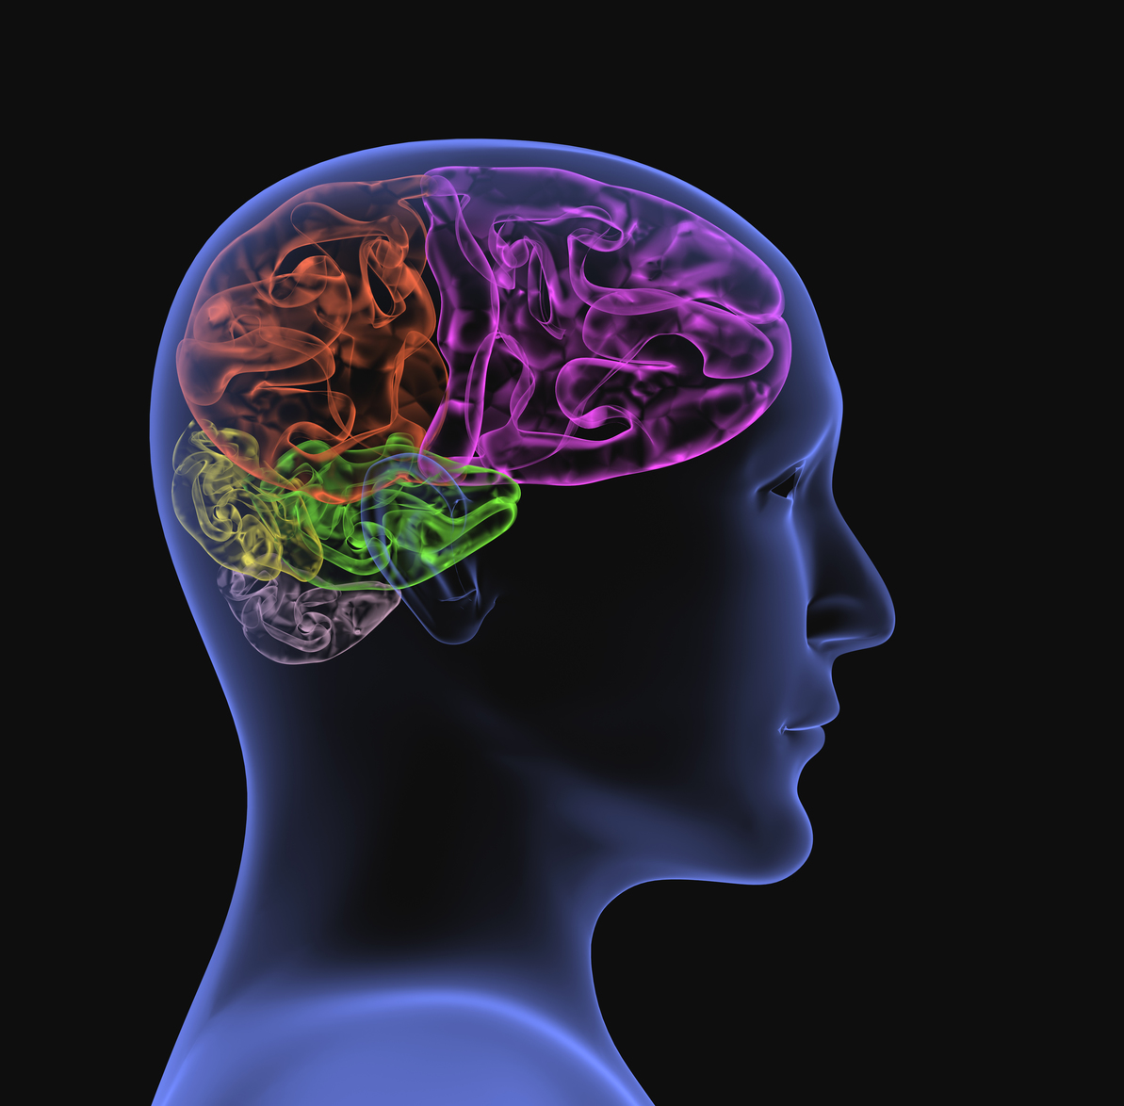
Ambiguous Pronunciation
“Put your heart, mind, and soul into even your smallest acts. This is the secret of success.”
Swami Sivananda
Notes:
Words that have same pronunciation – hard to capture the semantics (meaning of words)
By reading this, it’s easy to know that soul is not referring to sole (right foot), because we can see the spelling (and bottom of foot would make no sense)
Imagine if you simply heard this quote?
How do we determine the meaning of soul? How do we differentiate soul from sole?
Probabilistic approaches – given the surrounding words, how often does the bottom of foot occur?

Slide 7
Ambiguous Words
The bear crossed the river
The tree failed to bear fruit
Notes:
Problem in speech recognition and in understanding written language
- solve this with POS tagging
How do we humans understand this language? We know context!! Context is a major factor in understanding language

Slide 8
Context is Everything
Word by word translation does not work
Notes:
Walking in Russia with dictionary in hand and no body language is allowed – expressing meaningful phrases would be nearly impossible

Slide 9
Universal Grammar
Noam Chomsky
“the idea that human languages, as superficially diverse as they are, share some fundamental similarities, and that these are attributable to innate principles unique to language: that deep down, there is only one human language.”
Syntactic Structures
Notes:
Noam Chomsky – linguist back in the mid 20th century
Frontiers in Psychology journal explains the idea of Universal Grammar
Chomsky published Syntactic Structures which explains that every language has a set of rules (grammars) and that through these rules there is an infinite amount of sentences to express.
This idea that understanding the grammars (rules) was the key to unlocking the human language led people to focus on the syntax of languages to derive semantics
Boise State professor – simple mathematical proof that confirms this idea of grammar allows for infinite expressible sentences

Slide 10
Rule-based NLP
What is it?
Pros
Cons
Hand-crafted rules
Linguists sit in a room and think of all possible rules associated with a language
Example: Context-Free Grammar
There is minimal training required for the AI agent to function
Not much else
Development is dependent on linguists forming rules
Not robust – there are many exceptions to rules in languages
High maintenance
Notes:
An example of a rule-based approach would be a context-free grammar. In a context-free grammar there is a start symbol, productions, nonterminating symbols, and terminating symbols. The productions are the rules that specify how to parse nonterminating symbols to eventually get to terminating symbols.
The popularity of this approach is most likely due to the fact that, since there wasn’t much computing power (well at least not enough required to perform machine learning algorithms)
Lack of statistical techniques

Slide 11
Statistical NLP
Statistical revolution in 80s/90s
Machine Learning
Notes:
systems the ability to automatically learn and improve from experience without being explicitly programmed.
Machine learning focuses on the development of computer programs that can access data and use it learn for themselves.”

Slide 12
Statistical NLP
What’s required
Main tasks
Computer
Corpora
Software
Tokenize
Analyze
Interpret the data
Notes:
Tokenize: The system will need to be able to extract words, sentences, and punctuations into tokens.
Analyze: The system will need to be able to extract the features of these tokenized words and sentences. Features can range from the sequence of words the preceded this word, to the morphology of a word, to even as simple as the number of times a word appears in a document.
Interpret the data: Run the features through some probabilistic model that will produce an output that gives direction or meaning to the NLP system.
The third task as mentioned above refers to having a probabilistic model with parameters and features that the system can update and tweak. This updating and tweaking of the model is what is how a machine can “learn”. There are many different types of probabilistic models in NLP, but two popular ones are Hidden Markov Models (HMMs) and Neural Networks.

Slide 13
Notes:
Machine Translation: machine translation is the transformation of text from one language to another performed automatically by a computer.
2 training corpora
Target language corpus – to learn what target language sentences look like, learn phrases
Source-Target corpus – to find correspondences between languages

Slide 14
Hidden Markov Models
“a tool for representing probability distributions over sequences of observations”
Markov Property
States are not fully observed
Notes:
Quote from International Journal of Pattern Recognition and Artificial Intelligence
Markov Property - at a given state, all pertinent data is supplied to predict the future states
Through observations (like audio waves, the word(s) preceding a word, the part of speech of a given word) we can infer states

Slide 15
Types of Hidden Markov Models
History-based model
First-order HMM
Mth-order HMM
Notes:
History-based model: Every word depends on all the preceding words --- That’s a ton of parameters!!! Lots of conditional probabilities to compute and does not scale well
First-order HMM (sometimes referred to as a bigram HMM): satisfies markov property: probability of next state solely depends on previous state
- problem with this? Realistically, it’s insufficient to only consider the preceding word…it’s difficult to truly capture context
Mth-order HMM: take the m preceding words into account

Slide 16
Notes:
State space is the current word we are trying to translate
Emission – the corresponding Spanish word
Differences – need to be sensitive to what is actually present on the English side (Is this truly an HMM – is state truly hidden??) and needs to remember context of current word
How do we keep track of context with HMM?
- this type of HMM is more complicated
- Probably use an mth-ordered HMM
- Probably have a POS-tagger to help with translation for disambiguation

Slide 17
Other application of NLP
Document Similarity
Optical Character Recognition (OCR)
Speech Recognition
Natural Language Generation (NLG)
Notes:
Document Similarity – algorithm to determine how similar documents are
OCR - ABBYY FineReader OCR allows businesses to convert documents in just about any format into data that can be easily analyzed and manipulated
Speech Recognition – Google Assistant, Siri, Cortana – allows for humans to interact with computers (Google analogy of humans trying to communicate with each other by writing messages to each other)
NLG - Natural Language Generation is the process of consuming data, interpreting that data, and producing an unbiased summary of the data in human-understandable language

Slide 18
Conclusion
Defined Natural Language Processing
Discussed main challenges
Described two main approaches of NLP
Hidden Markov Models
Modern applications of NLP

Slide 19
Questions

