Slide 1
Imputation
CSCI 446
Keith Bocian
11.16.2018

Slide 2
INTRODUCTION
______________
In the legal sense, the term imputed is used to describe an action, fact, or quality, the knowledge of which is charged to anindividual based upon the actions of another for whom the individual is responsible rather than on the individual's own acts oromissions. For example, in the law of agency, the actions of an agent performed during the course of employment will beattributed to the agent's principal. The doctrine of imputed Negligence makes one person legally responsible for thenegligent conduct of another.
When Data is missing we generally have a few options:
Avoid: Don’t use that attribute or class
Delete: remove the entire record
Ignore: Mark data as N/A
Impute: Replace value with ‘our best guess’, or as Wikipedia says:
“In statistics, imputation is the process of replacing missing data with substituted values.”

Slide 3
WHY IS IMPUTATION COOL?
ENHANCE!!!

Slide 4
OVERVIEW
Motivation
Relationship with AI
Methods – an overview
Choosing the Right Method
Case Studies

Slide 5
Motivation: Why Impute?
Imputation Improves Predictions or Understanding of Data
Useful in Fields:
Healthcare Imagery
Forensic Analysis
Sales Predictions
Understanding Evolution
Missing data abounds:
Many data sets are multidimensional
Missing data can hide useful information
Sample Bias makes accurate imputation difficult

Slide 6
Relationship with Artificial intelligence
Prepping the battlespace before we apply AI:
OR
Use AI to directly impute missing data:
Imputation
Imputation

Slide 7
Most Common, and Easy to Explain Methods
Hot Deck and Cold Deck: Choosing values from records that otherwise closely match the target
Mean Imputation: Applying the mean of other records
introduces bias
Underestimates random error
Regression
Calculate value of numerical
Data must be ‘transformable’ to linear model
Collinearity is an issue
KNN
Works well with smaller data sets

Slide 8
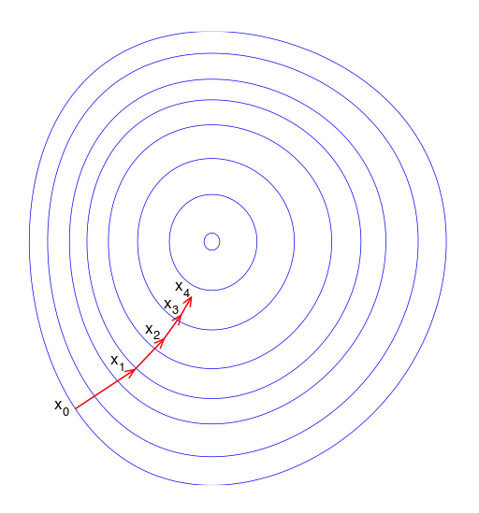
Methods: Involving Math, Stats, information theory
Expectation Maximization: better with little to no interdependency
Markov Chain Monte Carlo (e.g. Gibbs Sampling)
Naïve Bayes
Gradient Boosting Methods: CatBoost Vs LightGBM vs. XGBoost
Iterative Regression combines weaker models into a strong model
Gradient Descent: Find steepest path from one model to another
Singular Value Decomposition (SVD): Linear Algebra-based method used by Netflix; originally proposed in 1998

Slide 9
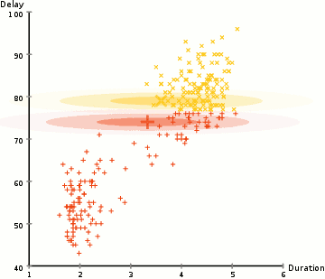
EXPECTATION MAXIMIZATION
An Iterative Method to find Max Likelihood, often of
parameters of statistical distributions
Old Faithful Eruption Data; an initial random model is fit to data
Model is gradually adjusted to parameters that maximize the likelihood
of Fitting the data

Slide 10
Singular value decomposition
Blue Unit Disc w/Two Canonical Unit Vectors
Action of M distorts unit disc into elipse
SVD decomposes M into three transformations:
Rotation V*
Scaling Σ along axes
Final rotation U; semi axes of ellipse are M[1,1] and M[2,2]
Resulting Decomposition M = U Σ V
Parellel Computation Speeds Results
Allows decomposition of huge matrices into simpler ones

Slide 11
Methods Involving AI
Neural-Networks:
Can model non-linear relationships; no requirements for input/residual distributions
Recurrent Neural Network Language Models (RNNLM)
SVM Classification: traditionally done for one binary classification decision, has been extended to perform multi-class predictions
https://www.youtube.com/watch?v=3liCbRZPrZA
Hyperplane allows for separation between classes; not limited in sense perceptron model was

Slide 12
Methods: Putting it all together
Ensemble of Models
Put together a bunch of models and find which ones work best for each data set
Computing power could limit application
Can be time-consuming to tune individual solutions

Slide 13
Choosing the right method (1/2)
Not a deterministic decision
Some guidelines:
Consider the dataset!
Independence of attributes: Naïve Bayes, use of dependent attributes
Is data set balanced? If not, and we are classifying: consider undersampling or oversampling
How much data do we have? Little data: use bootstrapping/bagging Too much data: need more computing power, avoid KNN or similar

Slide 14
Choosing the right method (2/2)
Guidelines, continued
About the data we’re attempting to impute:
Numerical? Categorical? Ordinal?
Cardinality of imputed Data? SVM good for 2 classes; need to supplement w/binary decision tree if >2 class values
How are missing data distributed?
How much computing power do we have? // How much time do we have for training? Simulation a possibility?
Sparsity of data set: SVD a possibility
Type of Missingness: MAR, MCAR, NMAR
Choose a baseline guide for performance and fess up when your model doesn’t work
Wild West: utility trumps theoretical justification

Slide 15
Case Studies
Case study: #1: Neural Network for imputation of Genetic data
Gene data…interested to understand breakpoints between groups of genes
Where is information missing
Where is information replicated
Assists with developing intuition for neural networks
Case study: #2: Markov Chain Monte Carlo vs. Imputing the Mean
https://www.kaggle.com/scirpus/markov-chain-monte-carlo
Case Study #3: SVM for imputing classification
https://www.kaggle.com/pierra/credit-card-dataset-svm-classification

Slide 16
SUMMARY
Motivation
Relationship with AI
Methods – an overview
Choosing the Right Method
Case Studies

Slide 17
QUESTIONS?

Slide 18
Modalities of Missing data
Missing at Random: Probability of missing data depends on observed variables: Recoverable
Missing Completely at Random: Not dependent on any observed variable…Testable!
Focus on missing data models
Not Missing at Random: Missing Data depends on values of missing attributes…Cannot Reconstruct…Need more Data!
Missingness models must be specified

