Slide 1
Generative Adversarial Networks
Ngoc Ha

Slide 2
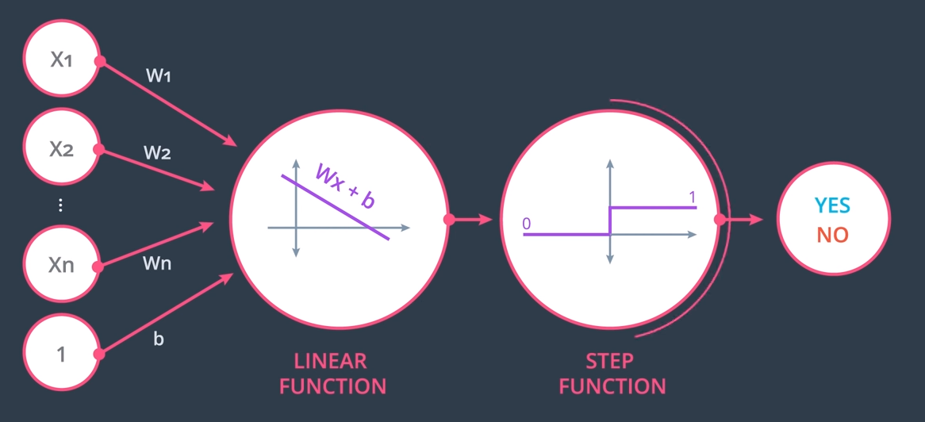
Perceptron

Slide 3
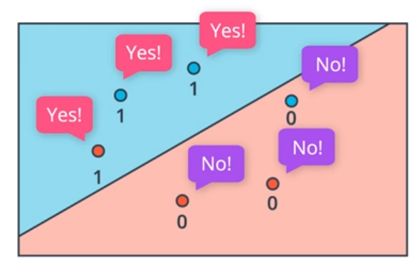
Binary Decisions

Slide 4
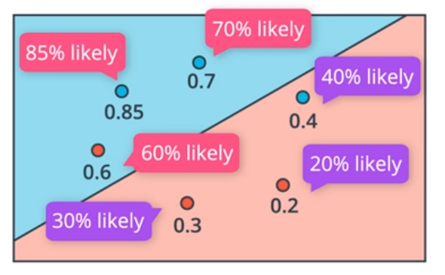
Probability?

Slide 5
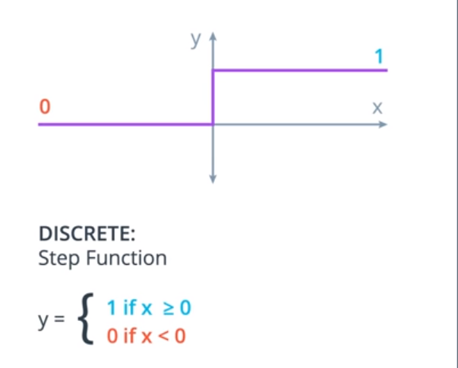
Activation functions

Slide 6
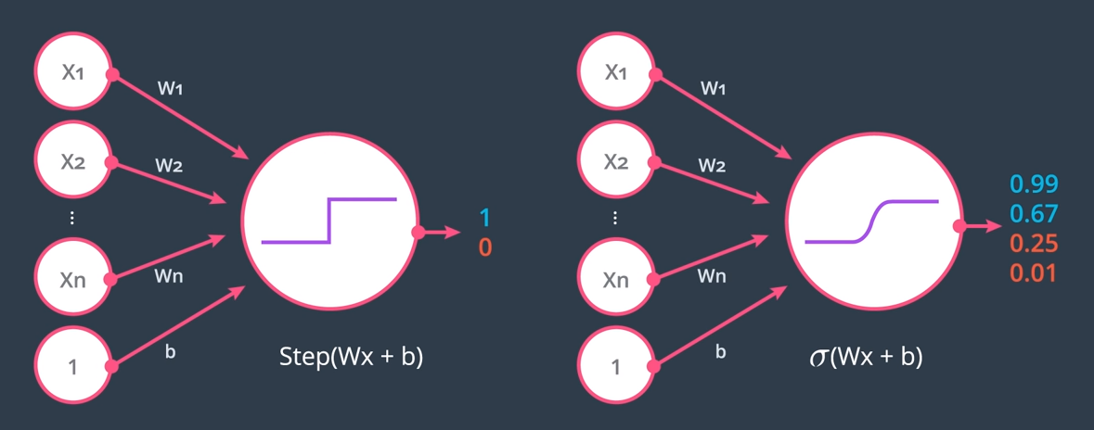
Perceptron with sigmoid activation

Slide 7
Loss function
$E= −\frac{1}{m}\sum_{i=1}^{m}{(y_{i}\log\left({\hat{y}}_{i}\right)+(1−y_{i})\log\left(1−{\hat{y}}_{i}\right))}$,
where the prediction is given by ${\hat{y}}_{i}= σ(Wx^{\left(i\right)}+b)$.
Loss function tells us how badly our model is fitting the data.
Our goal is to minimize the loss function.

Slide 8
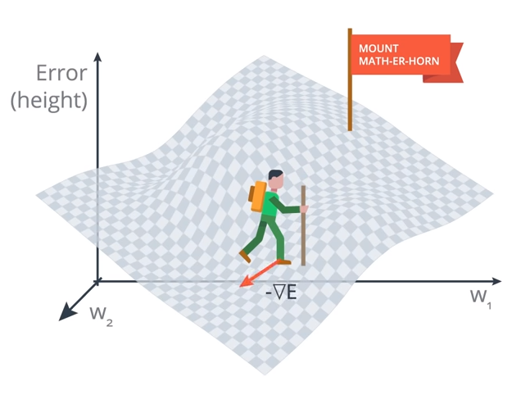
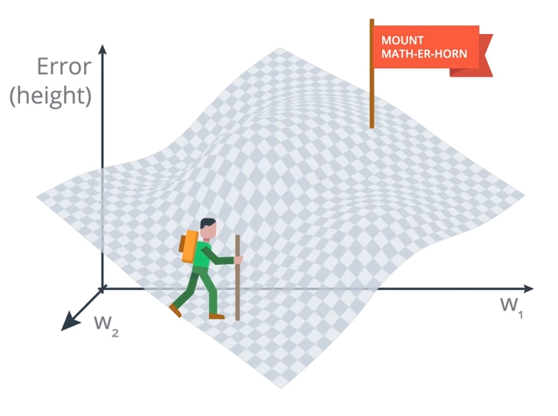
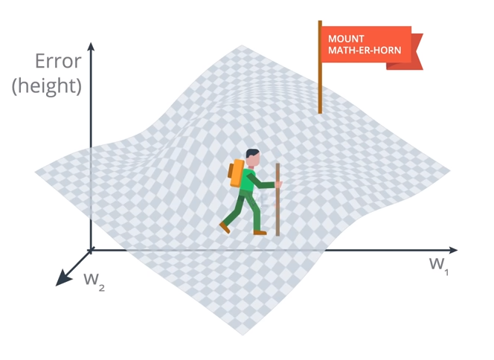
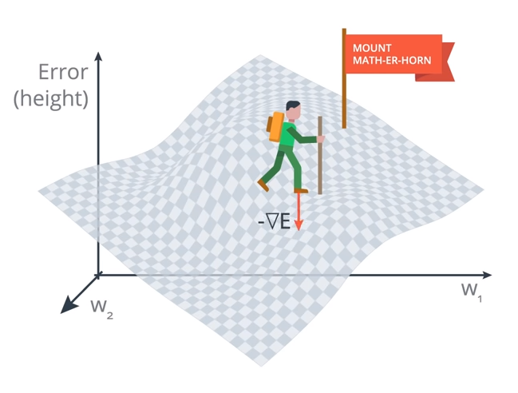
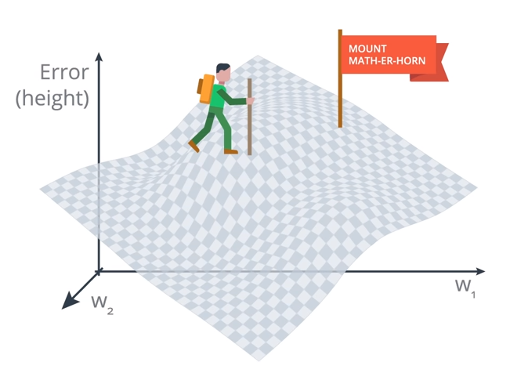
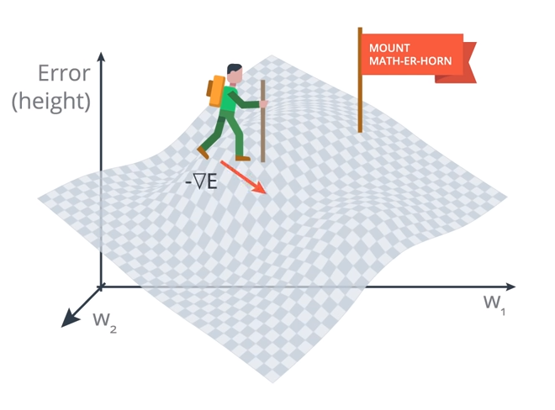
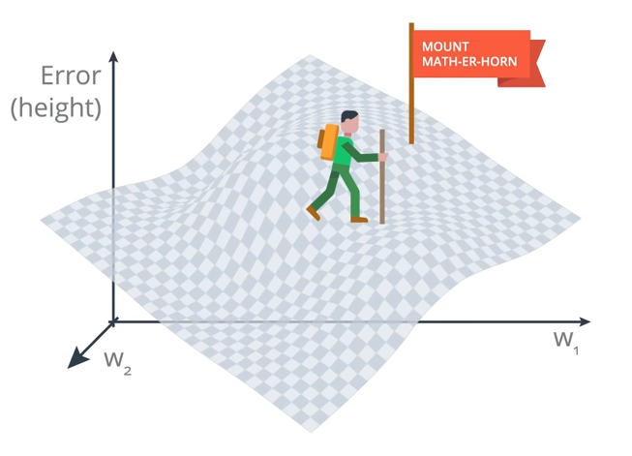
Gradient descent

Slide 9
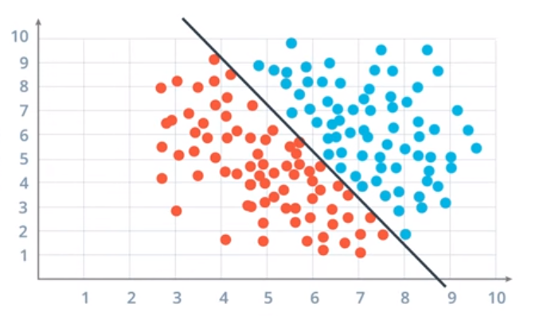
Linearly separable data

Slide 10
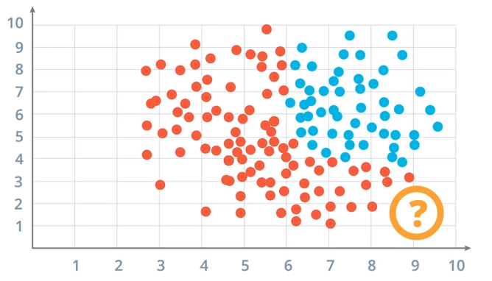
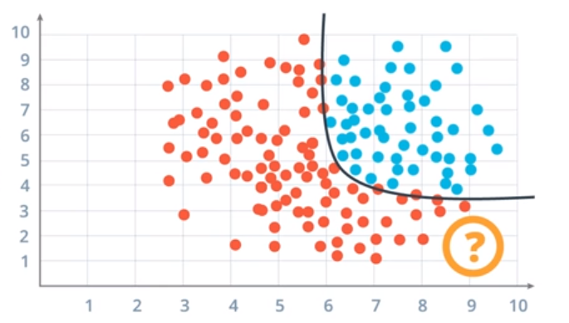
Non-linear decision boundary

Slide 11
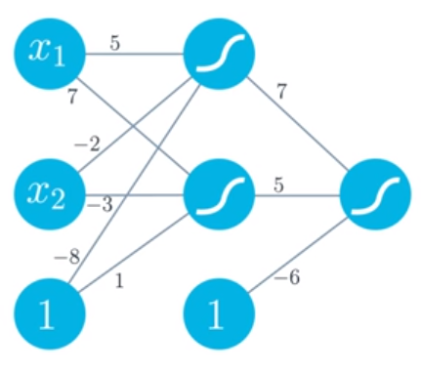
Neural network

Slide 12
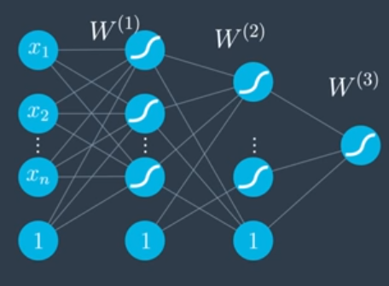
Deep Neural Network

Slide 13
Backpropagation
A method to calculate the gradient of the loss function by using the chain rule.

Slide 14
Discriminative Models
Discriminative models: learn a direct mapping from inputs x to the class labels y – or learn the posterior distribution P(y|x) directly.

Slide 15
Generative Models
Learn P(x|y) and the class priors P(y) to derive the joint probability P(x,y), and
Make predictions by using Bayes rules to calculate P(y|x), then
picking the most likely label y, usually by maximum likelihood estimation.
Think Naïve Bayes

Slide 16
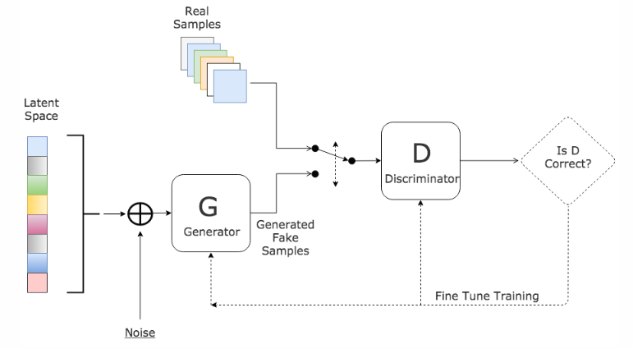
Generative Adversarial Networks

Slide 17
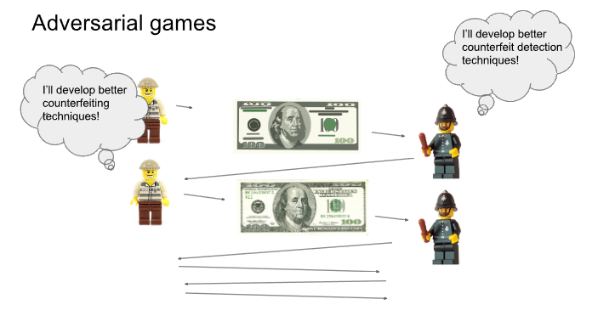
GAN Analogy

Slide 18
GAN visualization

Slide 19
Generative Adversarial Networks
Problem: want to generate samples from complex, high-dimensional training distribution (images, videos…). No direct way to do this!
Solution: Sample from a simple distribution, e.g. random noise. Learn (very complex) transformation to training distribution.
Q: What can we use to represent this complex transformation?
A: A neural network! (usually deep convolutional networks)

Slide 20
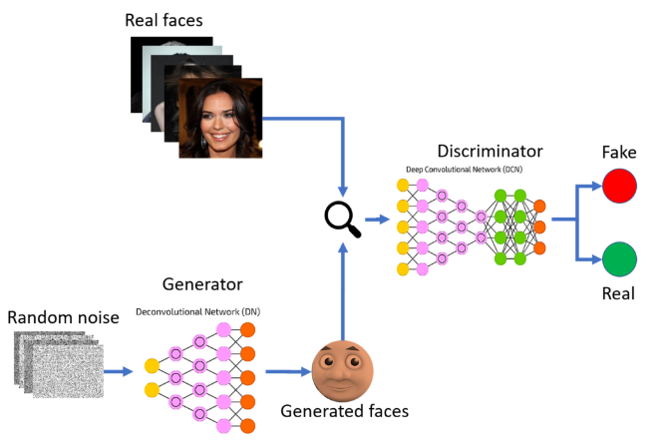
Deep Convolutional GAN

Slide 21
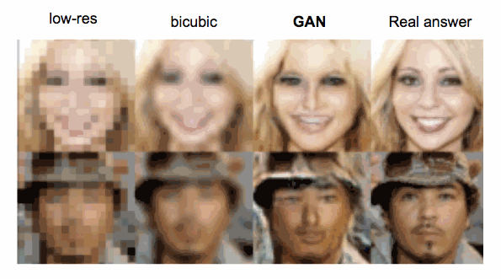
GAN application – Enhance!

Slide 22
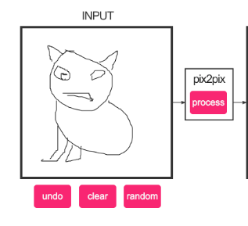
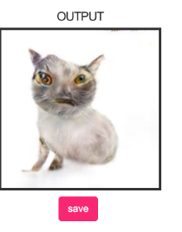
Image-to-image translation

Slide 23
Video-to-video translation

Slide 24
Text to image

Slide 25
But wait…
Can we do all these things with non-deep-learning software?

Slide 26
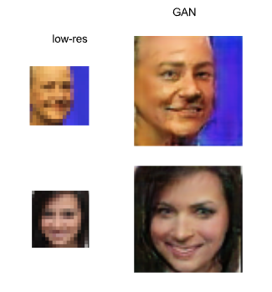
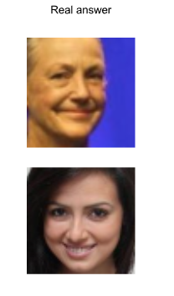
GANs are not perfect

Slide 27
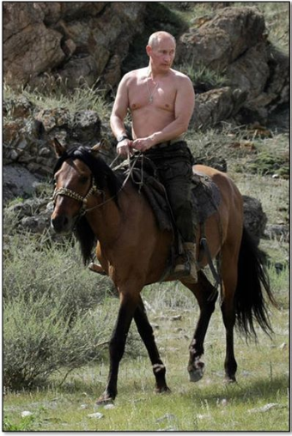
GANs are not perfect

