Slide 1
Decision Trees
By Cole Daily
CSCI 446

Slide 2
Overview
What are decision trees
Visualizing a tree
Types of trees
Building a tree
Pruning a tree
Advantages and Disadvantages

Slide 3
What are Decision Trees?
Predictive model
Use previous experience
Find the value of a target variable
Efficient after built

Slide 4
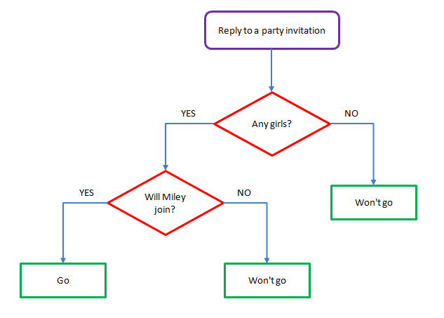
Visualizing a tree
Types of nodes
Root
Decision
Leaf

Slide 5
Types of Trees
CART
Classification
Regression
Decision stream
Ensembles
Boosted Trees
Bootstrap Aggregate
Rotation Forest

Slide 6
Building a Decision Tree
Recent | Relevant | Time | Read
y | y | y | y
n | n | y | n
y | n | n | n
y | n | n | n
n | y | y | y
n | y | y | y
n | n | n | n
y | y | y | y
y | y | n | y
y | n | n | y

Slide 7
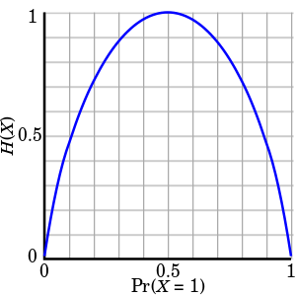
Entropy
“Measure of information in a single random variable”
Ranges from 0 to 1
0 – No information possible
1 – Maximum information possible
Maxes when possibilities are equally likely

Slide 8
Information Gain
Measure of information gained from a split
Sum the entropy of each possible value
Subtract from the entropy before
Good for Classification trees

Slide 9
General Method for Building a Tree
Determine best split using some method
Split
Repeat until:
Leaves are pure
No splits possible
Splitting is not useful
Prune

Slide 10
The example
Get information gain of each variable
Recent = (- ⅗log₂⅗ - ⅖log₂⅖) -(((- ⅔log₂ ⅔ – ⅓ log₂ ⅓) + (- ½log₂ ½ - ½log₂ ½)) / 2) = .014
Recent doesn’t purify the leaf nodes
Best split is Relevant
Relevant true – read article
Relevant false – 20% read article
Recent | Relevant | Time | Read
y | y | y | y
n | n | y | n
y | n | n | n
y | n | n | n
n | y | y | y
n | y | y | y
n | n | n | n
y | y | y | y
y | y | n | y
y | n | n | y

Slide 11
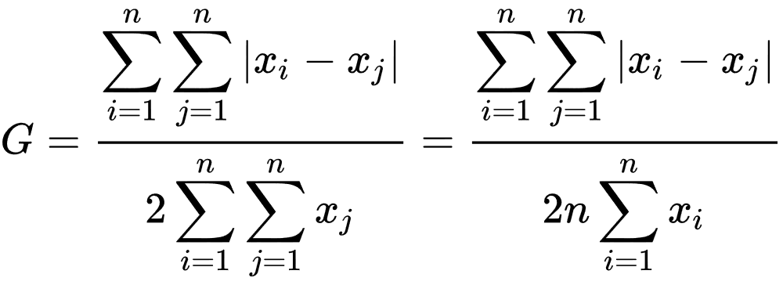
The Gini Coefficient
Developed by statistician Corrado Gini
Used to determine wealth distribution over a population
Relative mean absolute difference
0 – Maximum equality
1 – Maximum inequality

Slide 12
Variance Reduction
Used for continuous target variables
Reduce the variance in possible values of each leaf node
Good for regression trees
Similar to Gini Coefficient

Slide 13
Pruning
Stopping conditions:
No more splits
Splits are not useful
Leaves are pure
Overfitted to training data
Inaccurate in practice

Slide 14
Pruning
General pruning method:
Replace subtree with leaf node
Check accuracy of tree
If improved, keep leaf node
If not, keep subtree
Reduced-Error Pruning
Take most popular outcome in a subtree and replace subtree with it
Fastest and easiest pruning method
Doesn’t guarantee an optimal tree

Slide 15
Cost-Complexity Pruning
Generate a series of trees starting
Consider a subtree and replace with a leaf node
Subtree used decided by rate of error/number of leaves
The subtree that minimizes this is used
Use the new subtree as the starting tree and repeat
End when only the root node is left
Check accuracy of all trees

Slide 16
Advantages and Disadvantages
Advantages:
Easy to visualize
Simple concept
Disadvantages
Complex to build
Lots of math
Used mostly in data mining and artificial intelligence
Can be applied any field that makes decisions

Slide 17
Conclusion
What are decision trees
Visualizing
Types
Building
Pruning
Advantages and Disadvantages

Slide 18
Sources
Brownlee, J. (2017, September 20). Classification And Regression Trees for Machine Learning. Retrieved November 20, 2018, from https://machinelearningmastery.com/classification-and-regression-trees-for-machine-learning/
Decision Tree AnalysisChoosing by Projecting "Expected Outcomes". (n.d.). Retrieved November 20, 2018, from https://www.mindtools.com/dectree.html
Decision tree implementation using Python. (2018, February 11). Retrieved November 20, 2018, from https://www.geeksforgeeks.org/decision-tree-implementation-python/
Decision tree learning. (2018, November 20). Retrieved November 20, 2018, from https://en.wikipedia.org/wiki/Decision_tree_learning
Decision tree pruning. (2018, November 16). Retrieved November 20, 2018, from https://en.wikipedia.org/wiki/Decision_tree_pruning
Elomma, T., & Kaariainen, M. (2001, January 09). Retrieved November 20, 2018, from https://www.jair.org/index.php/jair/article/view/10284/24526
Gini coefficient. (2018, November 12). Retrieved November 20, 2018, from https://en.wikipedia.org/wiki/Gini_coefficient
Gini coefficient. (2018, November 12). Retrieved November 20, 2018, from https://en.wikipedia.org/wiki/Gini_coefficient
Variance reduction. (2018, March 21). Retrieved November 20, 2018, from https://en.wikipedia.org/wiki/Variance_reduction
Zhao, L., Nagamochi, H., & Ibaraki, T. (2005, January). Greedy Splitting Algorithms for Approximating Multiway Partition Problems. Retrieved November 20, 2018, from https://www.researchgate.net/profile/Liang_Zhao33/publication/220589424_Greedy_splitting_algorithms_for_approximating_multiway_partition_problems/links/004635267b9e5a3ed1000000/Greedy-splitting-algorithms-for-approximating-multiway-partition-problems.pdf?origin=publication_detail

