Slide 1
AI and Robotics
CSCI 446 : Artificial Intelligence Presentation
By Sam Lloyd

Slide 2
Outline
Clarification
History
Languages and Models
Uses of AI in Robotics
Fields of Application
Boston Dynamics

Slide 3
Clarifications
AI
Narrow
Does one thing extremely well at the exception of other areas
General
Able to perform equal to or better than its human counterpart
Robotics
No AI – executes specific patterns
‘Dumb’ AI – has an AI but that AI does not learn
Intelligent Robots – able to learn and make decisions on its own

Slide 4
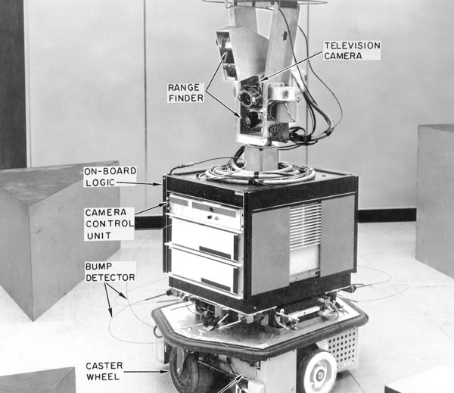
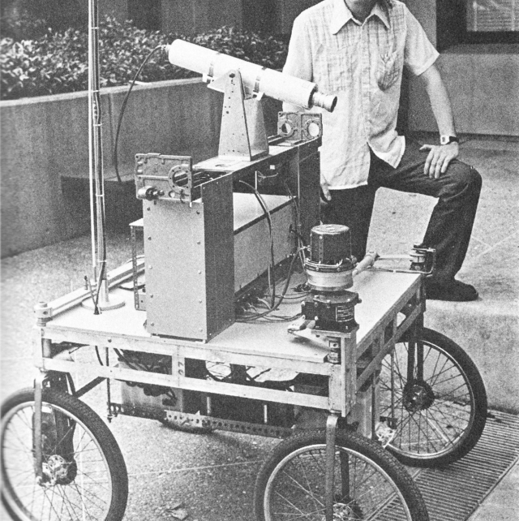
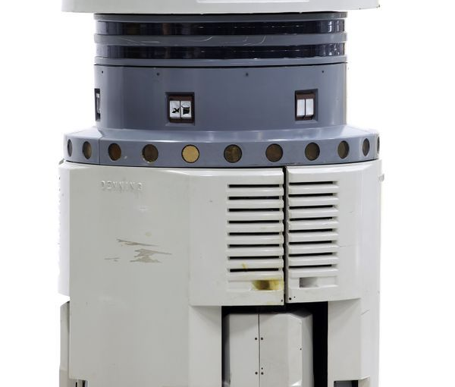
History of Intelligent Robots
1941 – Isaac Asimov’s credited with coining the term ‘Robot’ and publishing his ‘Three Laws of Robotics’
1970 – ‘Shakey the Robot’
1979 – Stanford Cart
1985 – Denning Sentry Robot
1989 – Chess problem solved MQ-1 Predator Drone
1997 – Deep Blue

Slide 5
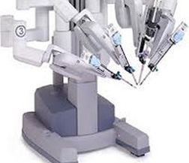
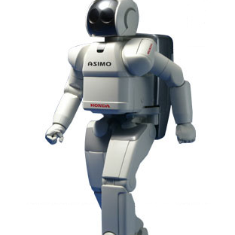
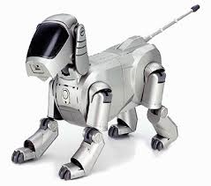
History of Intelligent Robots
1999 – Aibo
2000 – Honda’s Asimo DaVinci Surgical System
2002 – Roomba
2004 – First Mars rover
2007 – checkers problem solved
2010 – IBM’s Watson

Slide 6
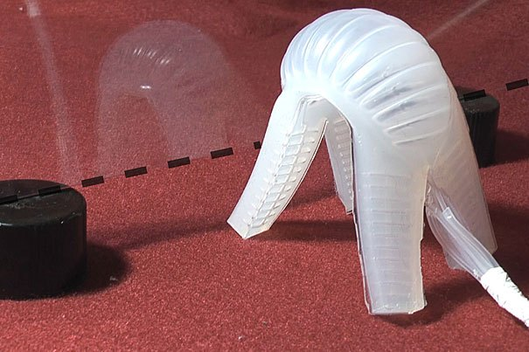
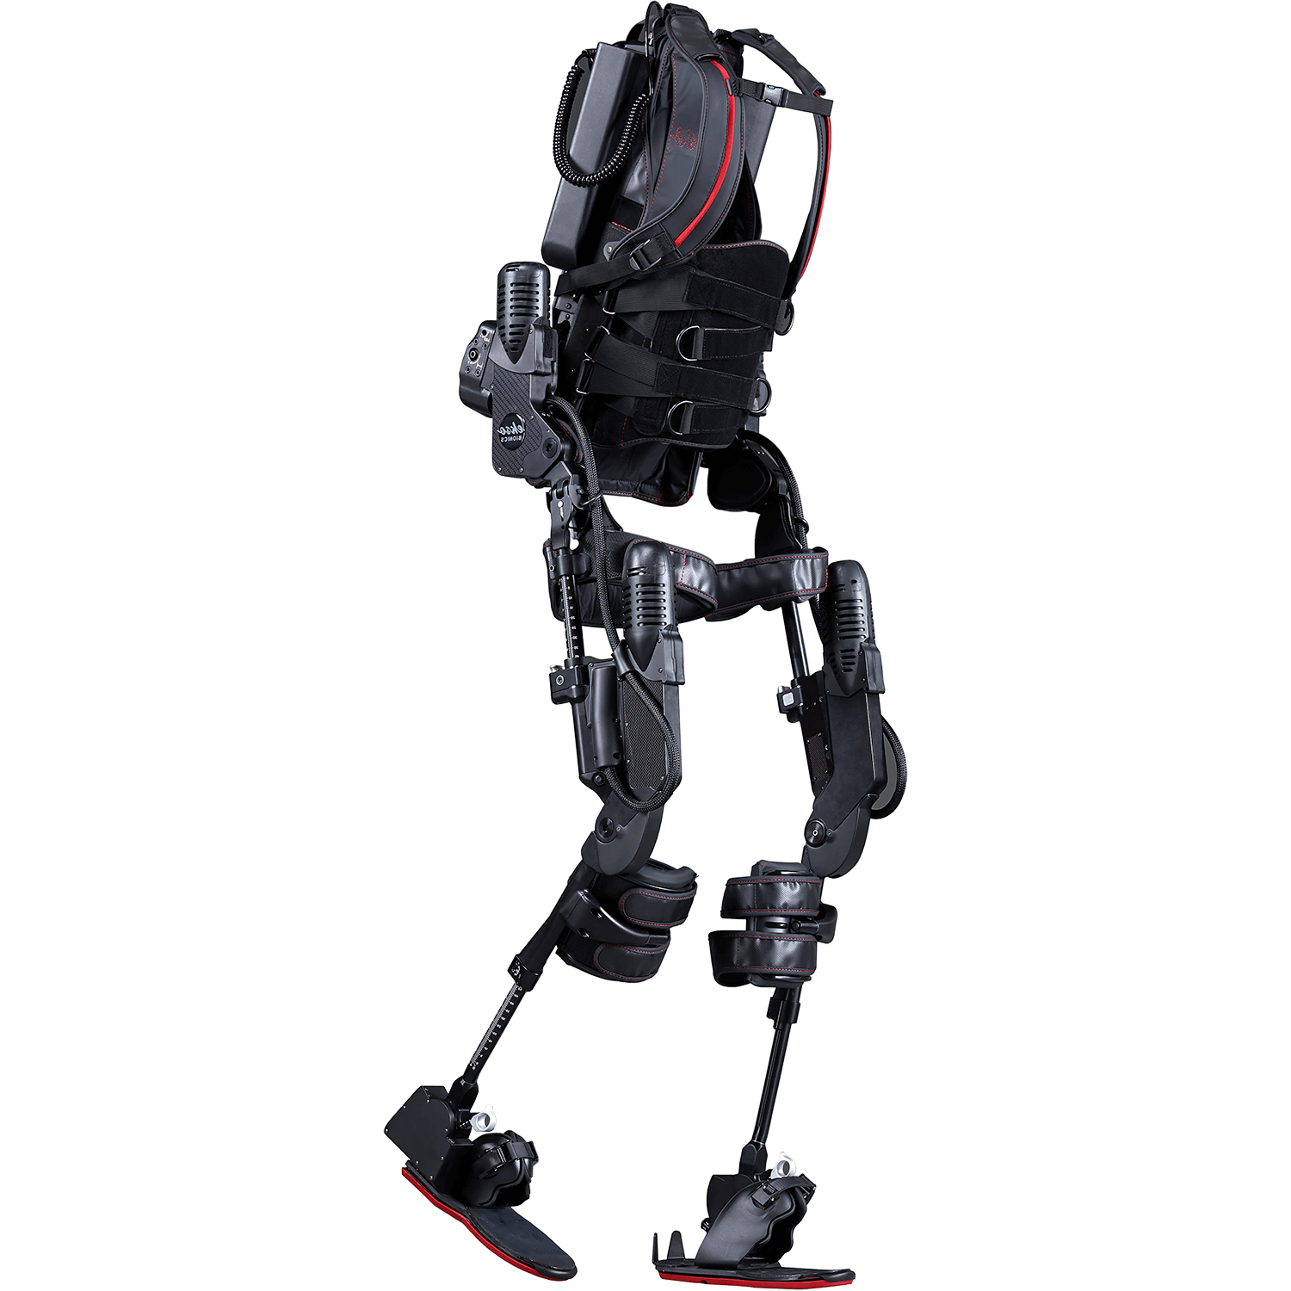
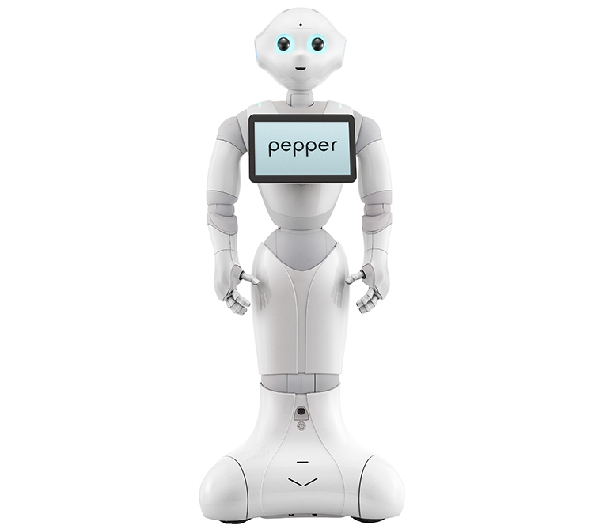
History of Intelligent Robots
2014 – Pepper Working exoskeleton by Ekso Bionics
2016 – Harvard’s first soft robot Polytechnique’s nanotransporter-bots
2017 – Go problem solved by Google DeepMind

Slide 7
Languages and Models
AI – LISP, Prolog, Python, R, Java
Robotics – Pascal, Hardware Description Language (HDL), Assembly
Machine Learning
Supervised and Semi-Supervised
Unsupervised
Reinforcement
Deep Learning

Slide 8
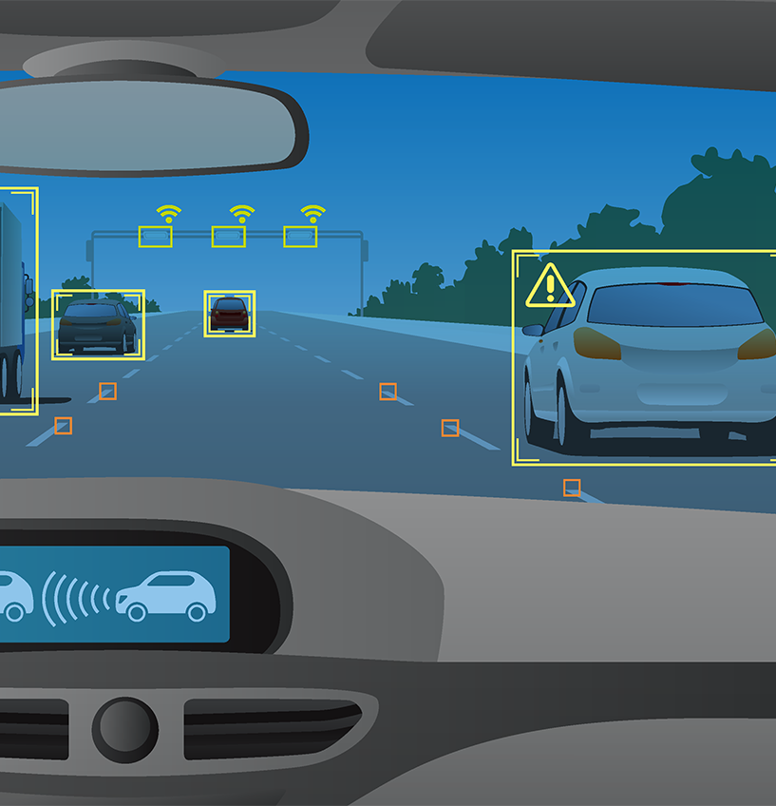
Uses of Artificial Intelligence in Robotics
Machine Vision
Cameras
Sensors

Slide 9
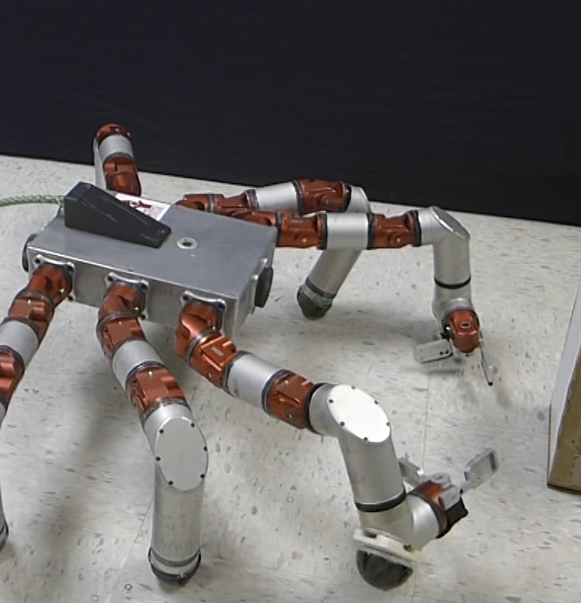
Uses of Artificial Intelligence in Robotics
Robot Locomotion and Manipulation
Moving
Determining next position
Balancing
Picking up items
Moving items

Slide 10
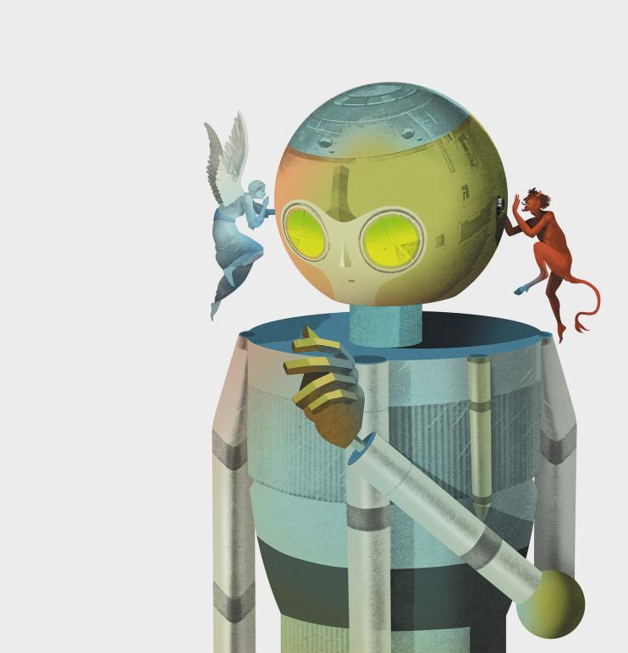
Uses of Artificial Intelligence in Robotics
Decision Making
Movement
Actions
Priority
Ethical
Moral

Slide 11
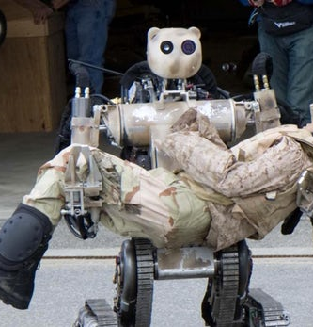
Field Applications – Military
BEAR
Battlefield Extraction-Assist Robot
Can lift and carry 500 pounds
Currently is remoted controlled
Future versions will include controlling the BEAR through recognizing hand signals

Slide 12
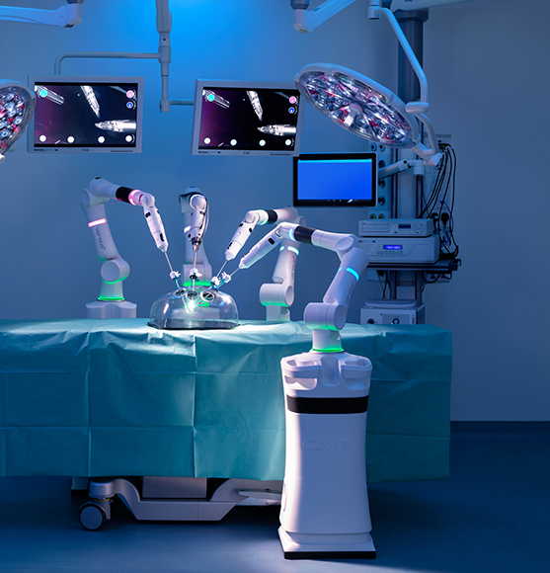
Field Applications – Medical
Versius
Used for hernia repairs and ear, nose, and throat operations
Controlled by the surgeon viva its console
It self-monitors itself 5,000 times per second
Successor of the DaVinci Surgery System

Slide 13
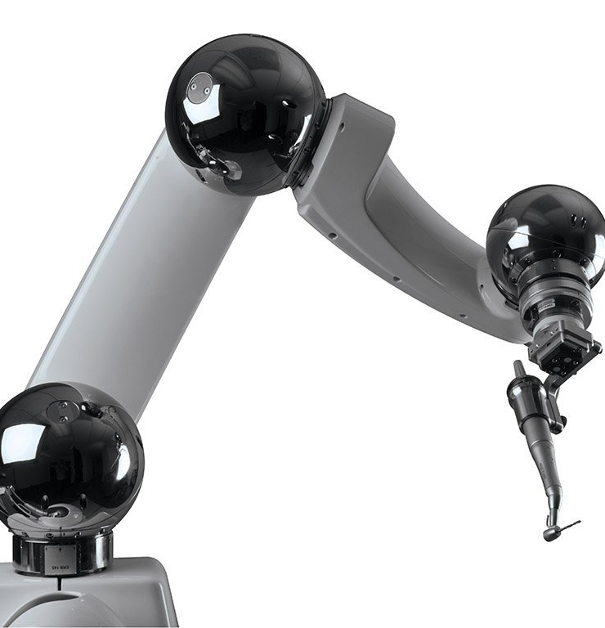
Field Applications – Medical
Yomi
Works alongside the doctor
Takes the patients CAT scan and uses it to pre-plan the procedure
Successfully fitted two implants with an error margin of 0.2-0.3mm during its trail in China in 2016

Slide 14
Field Applications – Medical
Tug
Small logistics robot
Delivers food, drugs, and other supplies
Equipped with 360° LIDAR
Can maneuver around patients and staff

Slide 15
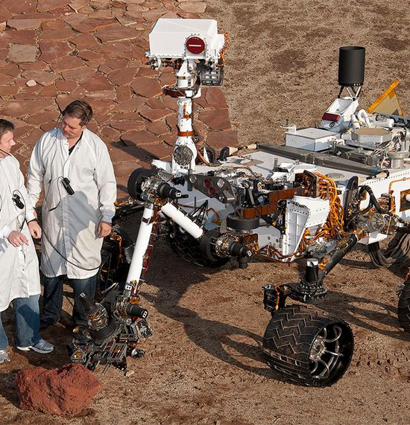
Field Applications – NASA
Curiosity
Landed on Mars August 6th, 2012
Confirmed to still be working as of November 2018
17 different cameras
14 different scientific instruments

Slide 16
Boston Dynamics
Atlas
https://www.bostondynamics.com/atlas
Handle
https://www.bostondynamics.com/handle
Spot
https://www.bostondynamics.com/spot

Slide 17
Conclusion
Clarification
History
Languages and Models
Uses of AI in Robotics
Fields of Application
Boston Dynamics

